Slide 1

Modeling Multiple, Related Uncertainties

Slide 2
Your List This Week
All COUs in Lesson 4
Problem solving sessions this week

Slide 3

Motivation & Example – the Guardianship Dilemma
Joint Uncertainty, Joint Events, Joint Probability
Marginal Uncertainty, Marginal Probability
Conditional Uncertainty, Conditional Probability
The Marginal-Conditional Method of Modeling Joint Uncertainty
z

Slide 4
Terminology and Notation
Relationships
Joint Event
Joint Probability
Marginal Uncertainty
Marginal Probability
Conditional Uncertainty
Conditional Probability
Joint Probability
Marginal Probability
Marginal Probability
Joint Probability
Conditional Probability

Slide 5
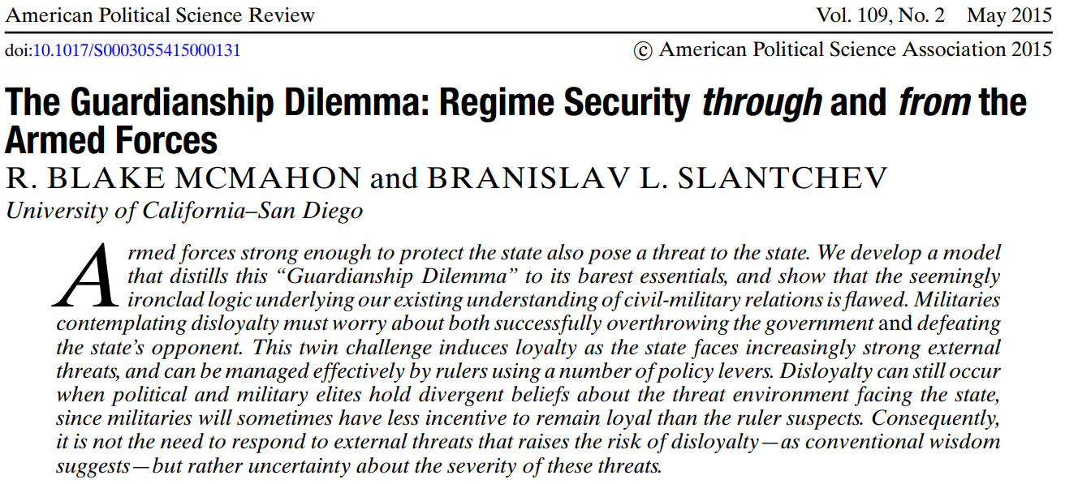

Slide 6
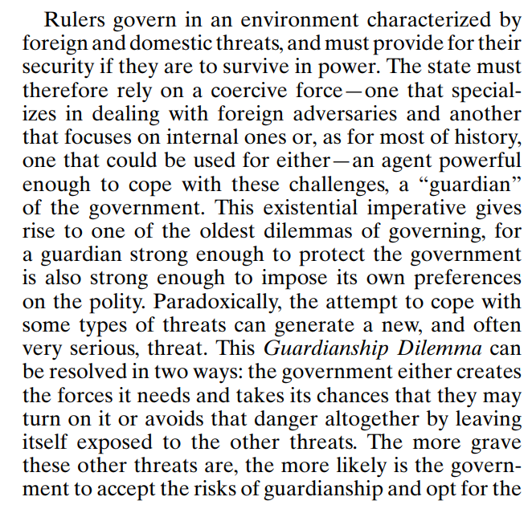

Slide 7
In the shortest and simplest terms possible...
What do McMahon and Slantchev mean by the “Guardianship Dilemma” and what are the two ways a state can resolve it?

Slide 8
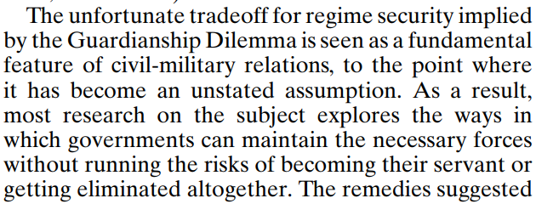
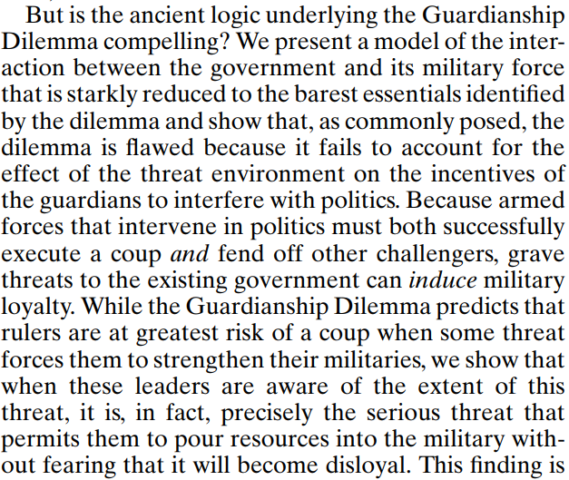

Slide 9
In the shortest and simplest terms possible...
What’s the most basic and important difference between the existing literature’s analysis of the Guardianship Dilemma and the implications of McMahon and Slantchev’s model of the Guardianship Dilemma?

Slide 10
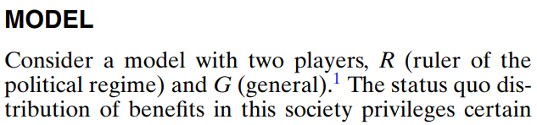
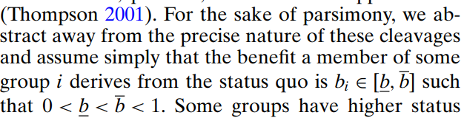
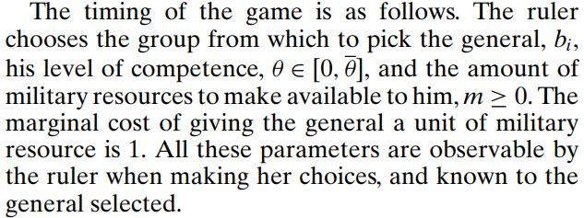

Slide 11
Summary:

Slide 12
Summary:
Ruler picks 3 characteristics of her military forces:

Slide 13
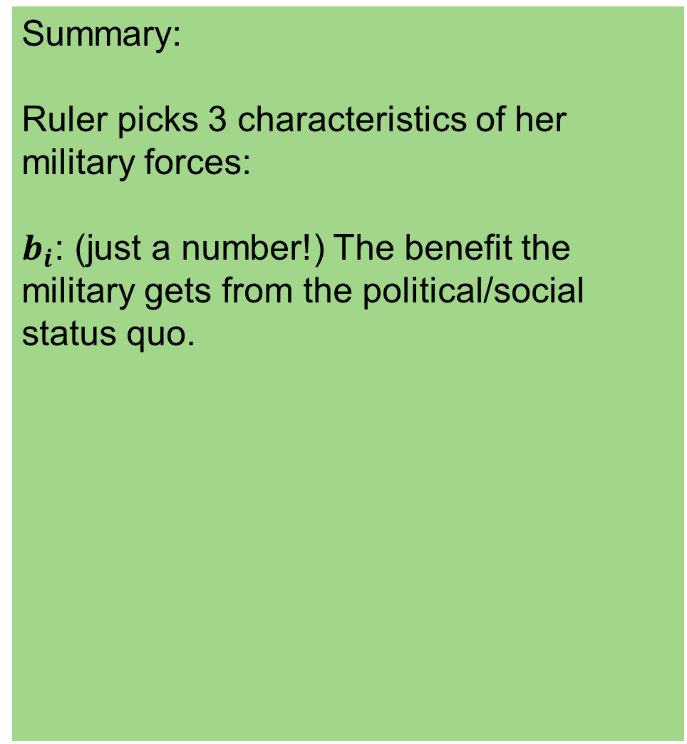
Summary:
Ruler picks 3 characteristics of her military forces:
$b_{i}$: (just a number!) The benefit the military gets from the political/social status quo.

Slide 14
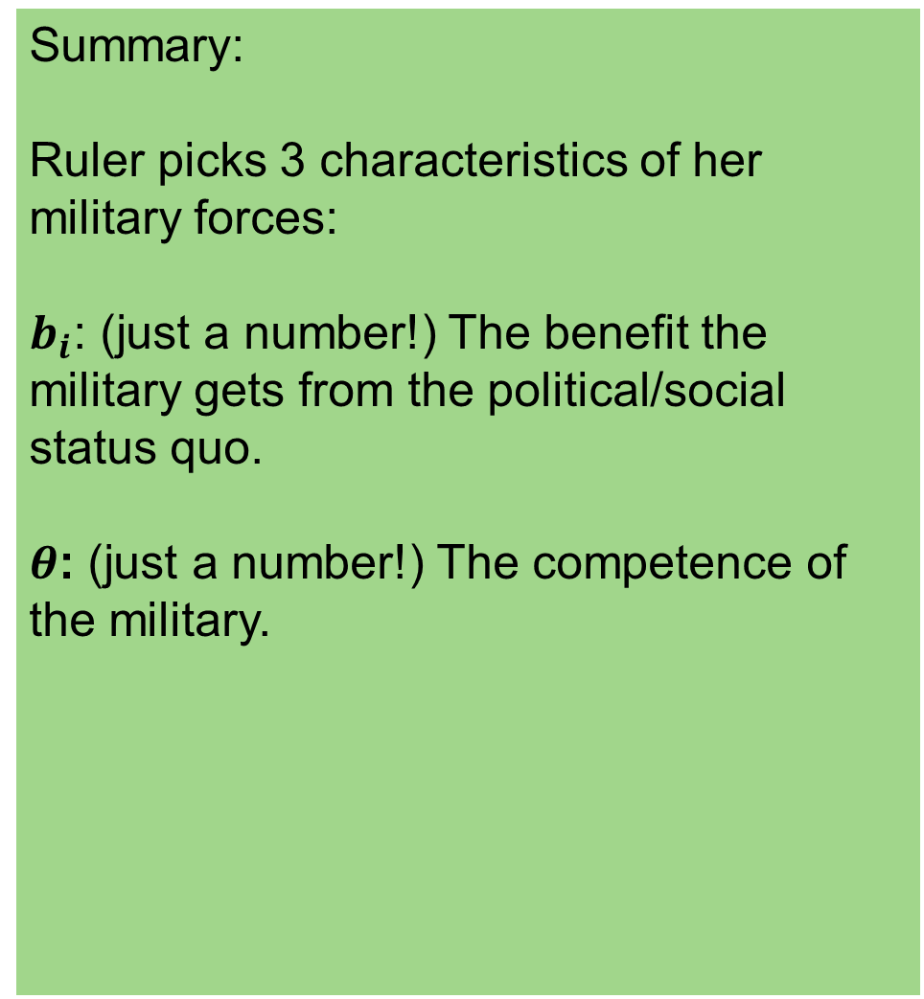
Summary:
Ruler picks 3 characteristics of her military forces:
$b_{i}$: (just a number!) The benefit the military gets from the political/social status quo.
$θ$: (just a number!) The competence of the military.

Slide 15
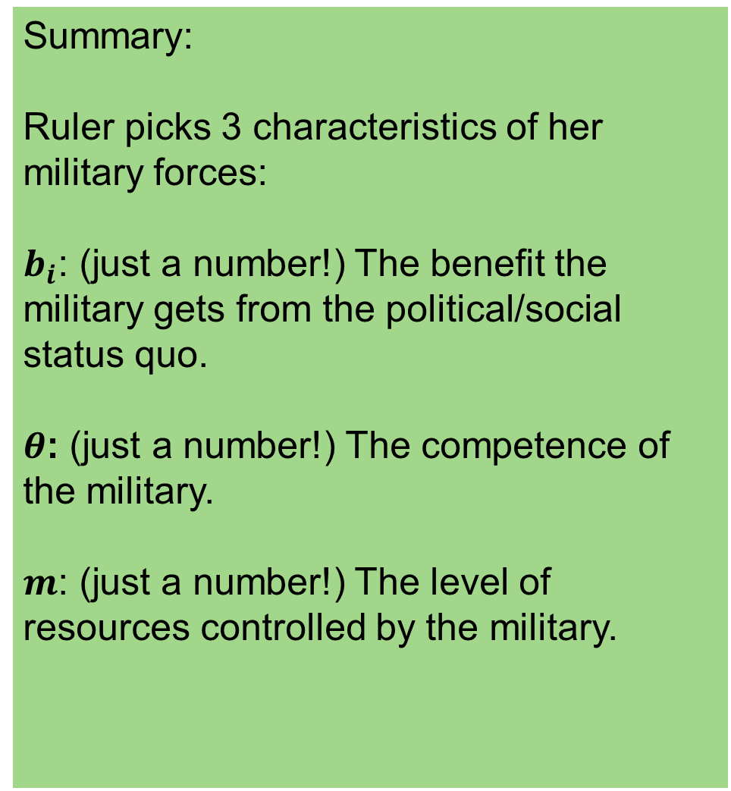
Summary:
Ruler picks 3 characteristics of her military forces:
$b_{i}$: (just a number!) The benefit the military gets from the political/social status quo.
$θ$: (just a number!) The competence of the military.
$m$: (just a number!) The level of resources controlled by the military.

Slide 16
Modeling the Uncertain Effects of the Ruler’s Choices

Slide 17
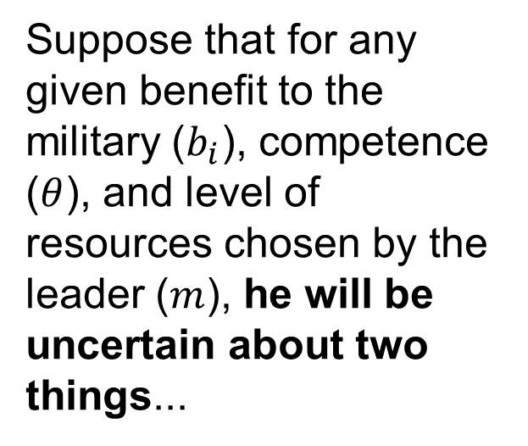
Modeling the Uncertain Effects of the Ruler’s Choices
Suppose that for any given benefit to the military ($b_{i}$), competence ($θ$), and level of resources chosen by the leader ($m$), he will be uncertain about two things...

Slide 18
Modeling the Uncertain Effects of the Ruler’s Choices
Suppose that for any given benefit to the military ($b_{i}$), competence ($θ$), and level of resources chosen by the leader ($m$), he will be uncertain about two things...
If the military’s leaders attempt a coup d'état, will it successfully overthrow the civilian government?
In the event of war with an opposing military force (whether a foreign military or domestic insurgency), to what extent will the military successfully prosecute the war?

Slide 19
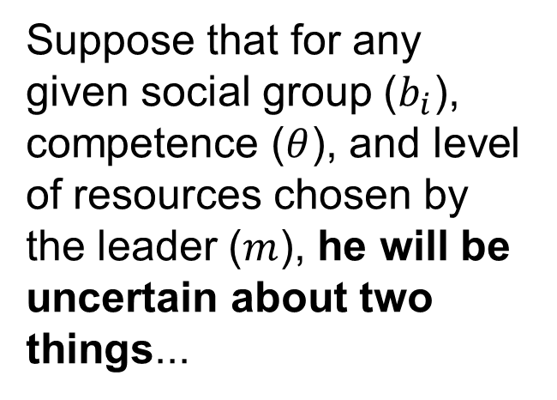
Modeling the Uncertain Effects of the Ruler’s Choices
The basic idea of McMahon’s and Slantchev’s analysis is that these two uncertainties are related.
Strong militaries are both more likely to successfully execute a coup and more likely to successfuly prosecute wars against foreign adversaries.
Suppose that for any given social group ($b_{i}$), competence ($θ$), and level of resources chosen by the leader ($m$), he will be uncertain about two things...
If the military’s leaders attempt a coup d'état, will it successfully overthrow the civilian government?
In the event of war with an opposing military force (whether a foreign military or domestic insurgency), to what extent will the military successfully prosecute the war?

Slide 20

Motivation & Example – the Guardianship Dilemma
Joint Uncertainty, Joint Events, Joint Probability
Marginal Uncertainty, Marginal Probability
Conditional Uncertainty, Conditional Probability
The Marginal-Conditional Method of Modeling Joint Uncertainty
z

Slide 21
Brute Force Approach (Don’t Do This)

Slide 22
Brute Force Approach (Don’t Do This)
Two Uncertainties
If the military attempts a coup, will it succeed?
If there is a war with an opposing military force, how well will the military perform in combat?

Slide 23
Brute Force Approach (Don’t Do This)
Remember: Every probabilistic model is just a list of possible events, and a probability distribution over those events.
Two Uncertainties
If the military attempts a coup, will it succeed?
If there is a war with an opposing military force, how well will the military perform in combat?

Slide 24
Brute Force Approach (Don’t Do This)
Remember: Every probabilistic model is just a list of possible events, and a probability distribution over those events.
Two Uncertainties
If the military attempts a coup, will it succeed?
If there is a war with an opposing military force, how well will the military perform in combat?

Slide 25
Brute Force Approach (Don’t Do This)
Remember: Every probabilistic model is just a list of possible events, and a probability distribution over those events.
Two Uncertainties
If the military attempts a coup, will it succeed?
If there is a war with an opposing military force, how well will the military perform in combat?
So how about this:

Slide 26
Brute Force Approach (Don’t Do This)
Remember: Every probabilistic model is just a list of possible events, and a probability distribution over those events.
Two Uncertainties
If the military attempts a coup, will it succeed?
If there is a war with an opposing military force, how well will the military perform in combat?
So how about this:
Event | Probability
An attempted coup will succeed, and military will perform poorly in combat
An attempted coup will succeed, and military will perform moderately in combat
An attempted coup will succeed, and military will perform excellently in combat
An attempted coup will fail, and military will perform poorly in combat
An attempted coup will fail, and military will perform moderately in combat
An attempted coup will fail, and military will perform excellently in combat

Slide 27
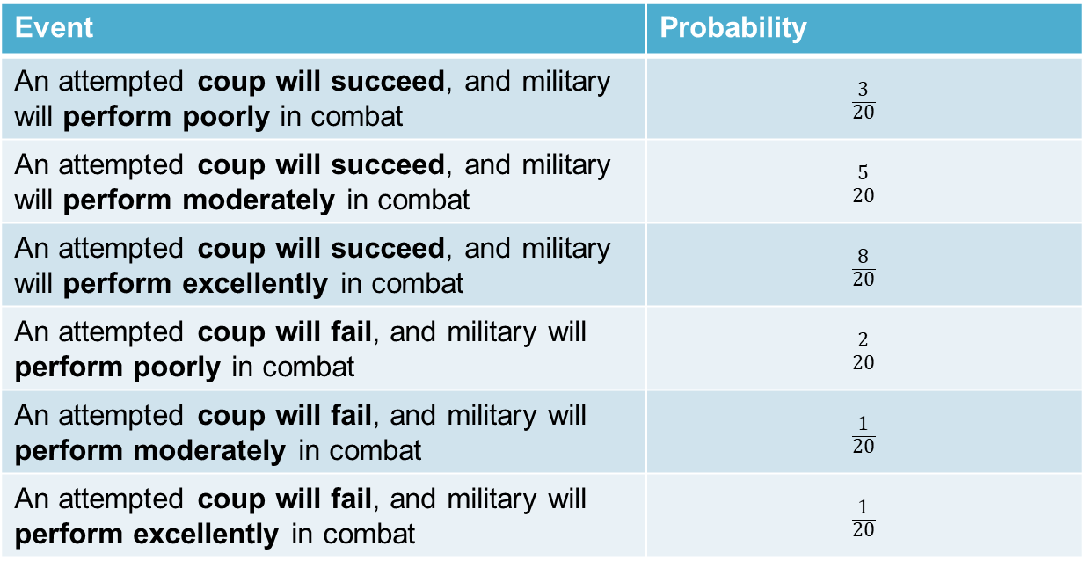
Brute Force Approach (Don’t Do This)
Remember: Every probabilistic model is just a list of possible events, and a probability distribution over those events.
Two Uncertainties
If the military attempts a coup, will it succeed?
If there is a war with an opposing military force, how well will the military perform in combat?
So how about this:
Event | Probability
An attempted coup will succeed, and military will perform poorly in combat | $$\frac{3}{20}$$
An attempted coup will succeed, and military will perform moderately in combat | $$\frac{5}{20}$$
An attempted coup will succeed, and military will perform excellently in combat | $$\frac{8}{20}$$
An attempted coup will fail, and military will perform poorly in combat | $$\frac{2}{20}$$
An attempted coup will fail, and military will perform moderately in combat | $$\frac{1}{20}$$
An attempted coup will fail, and military will perform excellently in combat | $$\frac{1}{20}$$

Slide 28
Joint Uncertainty, Joint Events, Joint Probabilities

Slide 29
Joint Uncertainty, Joint Events, Joint Probabilities
Two Uncertainties
If the military attempts a coup, will it succeed?
If there is a war with an opposing military force, how well will the military perform in combat?

Slide 30
Joint Uncertainty, Joint Events, Joint Probabilities
In the joint uncertainty approach, we try to think about the uncertainties one-at-a-time.
Two Uncertainties
If the military attempts a coup, will it succeed?
If there is a war with an opposing military force, how well will the military perform in combat?

Slide 31
Joint Uncertainty, Joint Events, Joint Probabilities
In the joint uncertainty approach, we try to think about the uncertainties one-at-a-time.
Two Uncertainties
When there are two uncertainties, we do this by making a grid to depict the possible resolutions of each uncertainty separately.
If the military attempts a coup, will it succeed?
If there is a war with an opposing military force, how well will the military perform in combat?

Slide 32
Joint Uncertainty, Joint Events, Joint Probabilities
In the joint uncertainty approach, we try to think about the uncertainties one-at-a-time.
Two Uncertainties
When there are two uncertainties, we do this by making a grid to depict the possible resolutions of each uncertainty separately.
If the military attempts a coup, will it succeed?
If there is a war with an opposing military force, how well will the military perform in combat?

Slide 33
Joint Uncertainty, Joint Events, Joint Probabilities
In the joint uncertainty approach, we try to think about the uncertainties one-at-a-time.
Two Uncertainties
When there are two uncertainties, we do this by making a grid to depict the possible resolutions of each uncertainty separately.
If the military attempts a coup, will it succeed?
If there is a war with an opposing military force, how well will the military perform in combat?
If coup attempted, will it succeed?

Slide 34
Joint Uncertainty, Joint Events, Joint Probabilities
In the joint uncertainty approach, we try to think about the uncertainties one-at-a-time.
Two Uncertainties
When there are two uncertainties, we do this by making a grid to depict the possible resolutions of each uncertainty separately.
If the military attempts a coup, will it succeed?
If there is a war with an opposing military force, how well will the military perform in combat?
If coup attempted, will it succeed?

Slide 35
Joint Uncertainty, Joint Events, Joint Probabilities
In the joint uncertainty approach, we try to think about the uncertainties one-at-a-time.
Two Uncertainties
When there are two uncertainties, we do this by making a grid to depict the possible resolutions of each uncertainty separately.
If the military attempts a coup, will it succeed?
If there is a war with an opposing military force, how well will the military perform in combat?
succeed
If coup attempted, will it succeed?
fail

Slide 36
Joint Uncertainty, Joint Events, Joint Probabilities
In the joint uncertainty approach, we try to think about the uncertainties one-at-a-time.
Two Uncertainties
When there are two uncertainties, we do this by making a grid to depict the possible resolutions of each uncertainty separately.
If the military attempts a coup, will it succeed?
If there is a war with an opposing military force, how well will the military perform in combat?
In a war, how well will the military perform?
succeed
If coup attempted, will it succeed?
fail

Slide 37
Joint Uncertainty, Joint Events, Joint Probabilities
In the joint uncertainty approach, we try to think about the uncertainties one-at-a-time.
Two Uncertainties
When there are two uncertainties, we do this by making a grid to depict the possible resolutions of each uncertainty separately.
If the military attempts a coup, will it succeed?
If there is a war with an opposing military force, how well will the military perform in combat?
In a war, how well will the military perform?
poorly
moderately
excellently
succeed
If coup attempted, will it succeed?
fail

Slide 38
Joint Uncertainty, Joint Events, Joint Probabilities
Two Uncertainties
If the military attempts a coup, will it succeed?
If there is a war with an opposing military force, how well will the military perform in combat?
In a war, how well will the military perform?
poorly
moderately
excellently
succeed
If coup attempted, will it succeed?
fail

Slide 39
Joint Uncertainty, Joint Events, Joint Probabilities
TRY IT
Imagine the mayor of a city trying to decide how big of a budget to give to his department of sanitation.
Suppose that for any given size of the budget, the mayor is uncertain about two things:
How much independent political power will the Commissioner of Public Works amass by selectively handing out contracts?
How satisfied will city resident’s be with the cleanliness of the city’s streets and sidewalks?

Slide 40
Joint Uncertainty, Joint Events, Joint Probabilities
TRY IT
Imagine the mayor of a city trying to decide how big of a budget to give to his department of sanitation.
Suppose that for any given size of the budget, the mayor is uncertain about two things:
How much independent political power will the Commissioner of Public Works amass by selectively handing out contracts?
How satisfied will city resident’s be with the cleanliness of the city’s streets and sidewalks?

Slide 41
Joint Uncertainty, Joint Events, Joint Probabilities
TRY IT
Imagine the mayor of a city trying to decide how big of a budget to give to his department of sanitation.
Suppose that for any given size of the budget, the mayor is uncertain about two things:
How much independent political power will the Commissioner of Sanitation amass by selectively handing out contracts?
How satisfied will city resident’s be with the cleanliness of the city’s streets and sidewalks?

Slide 42
Joint Uncertainty, Joint Events, Joint Probabilities
TRY IT
Imagine the mayor of a city trying to decide how big of a budget to give to his department of sanitation.
Suppose that for any given size of the budget, the mayor is uncertain about two things:
How much independent political power will the Commissioner of Sanitation amass by selectively handing out contracts?
How satisfied will city resident’s be with the cleanliness of the city’s streets and sidewalks?

Slide 43
Joint Uncertainty, Joint Events, Joint Probabilities
TRY IT
Imagine the mayor of a city trying to decide how big of a budget to give to his department of sanitation.
Suppose that for any given size of the budget, the mayor is uncertain about two things:
How much independent political power will the Commissioner of Sanitation amass by selectively handing out contracts?
How satisfied will city residents be with the cleanliness of the city’s streets and sidewalks?
Build a model of the mayor’s uncertainty about these two issues (without assigning probabilities...we’re getting to that!), and draw a grid to display your model.

Slide 44
Joint Uncertainty, Joint Events, Joint Probabilities
TRY IT
Imagine the mayor of a city trying to decide how big of a budget to give to his department of sanitation.
Suppose that for any given size of the budget, the mayor is uncertain about two things:
How much independent political power will the Commissioner of Sanitation amass by selectively handing out contracts?
How satisfied will city residents be with the cleanliness of the city’s streets and sidewalks?
Build a model of the mayor’s uncertainty about these two issues (without assigning probabilities...we’re getting to that!), and draw a grid to display your model.
STEP 1: DRAW A RECTANGLE

Slide 45
Joint Uncertainty, Joint Events, Joint Probabilities
TRY IT
Imagine the mayor of a city trying to decide how big of a budget to give to his department of sanitation.
Suppose that for any given size of the budget, the mayor is uncertain about two things:
How much independent political power will the Commissioner of Sanitation amass by selectively handing out contracts?
How satisfied will city resident’s be with the cleanliness of the city’s streets and sidewalks?
Build a model of the mayor’s uncertainty about these two issues (without assigning probabilities...we’re getting to that!), and draw a grid to display your model.
STEP 2: Label each axis as corresponding to one of the uncertainties
how much political power will the commissioner amass?
how satisfied will residents be?

Slide 46
Joint Uncertainty, Joint Events, Joint Probabilities
TRY IT
Imagine the mayor of a city trying to decide how big of a budget to give to his department of sanitation.
Suppose that for any given size of the budget, the mayor is uncertain about two things:
How much independent political power will the Commissioner of Sanitation amass by selectively handing out contracts?
How satisfied will city resident’s be with the cleanliness of the city’s streets and sidewalks?
Build a model of the mayor’s uncertainty about these two issues (without assigning probabilities...we’re getting to that!), and draw a grid to display your model.
STEP 3: Invent the list of possible resolutions of each uncertainty
None
Some
A lot
how much political power will the commissioner amass?
Not at all
Moderately
Completely
how satisfied will residents be?

Slide 47
Joint Uncertainty, Joint Events, Joint Probabilities
TRY IT
Imagine the mayor of a city trying to decide how big of a budget to give to his department of sanitation.
Suppose that for any given size of the budget, the mayor is uncertain about two things:
How much independent political power will the Commissioner of Sanitation amass by selectively handing out contracts?
How satisfied will city resident’s be with the cleanliness of the city’s streets and sidewalks?
Build a model of the mayor’s uncertainty about these two issues (without assigning probabilities...we’re getting to that!), and draw a grid to display your model.
STEP 4: Divide up and label each axis with the possible resolutions you invented
None
Some
A lot
how much political power will the commissioner amass?
completely
how satisfied will residents be?
moderately
not at all

Slide 48
Joint Uncertainty, Joint Events, Joint Probabilities
TRY IT
Imagine the mayor of a city trying to decide how big of a budget to give to his department of sanitation.
Suppose that for any given size of the budget, the mayor is uncertain about two things:
How much independent political power will the Commissioner of Sanitation amass by selectively handing out contracts?
How satisfied will city resident’s be with the cleanliness of the city’s streets and sidewalks?
Build a model of the mayor’s uncertainty about these two issues (without assigning probabilities...we’re getting to that!), and draw a grid to display your model.
STEP 4: Divide up and label each axis with the possible resolutions you invented
how much political power will the commissioner amass?
none
some
a lot
completely
how satisfied will residents be?
moderately
not at all

Slide 49
Joint Uncertainty, Joint Events, Joint Probabilities
Two Uncertainties
If the military attempts a coup, will it succeed?
If there is a war with an opposing military force, how well will the military perform in combat?
In a war, how well will the military perform?
poorly
moderately
excellently
succeed
If coup attempted, will it succeed?
fail

Slide 50
Joint Uncertainty, Joint Events, Joint Probabilities
The cells in the grid depict each distinct possible event as a conjunction of one resolution of one uncertainty with one resolution of the other uncertainty, helping us distinguish between the two uncertainties underlying each event.
Two Uncertainties
If the military attempts a coup, will it succeed?
If there is a war with an opposing military force, how well will the military perform in combat?
In a war, how well will the military perform?
poorly
moderately
excellently
succeed
If coup attempted, will it succeed?
fail

Slide 51
Joint Uncertainty, Joint Events, Joint Probabilities
TERMINOLOGY
Two Uncertainties
In any model of multiple uncertainties, any event that amounts to the conjunction of resolutions of each of a collection of single, distinct uncertainties is called a joint event.
If the military attempts a coup, will it succeed?
If there is a war with an opposing military force, how well will the military perform in combat?
In a war, how well will the military perform?
poorly
moderately
excellently
succeed
If coup attempted, will it succeed?
fail

Slide 52
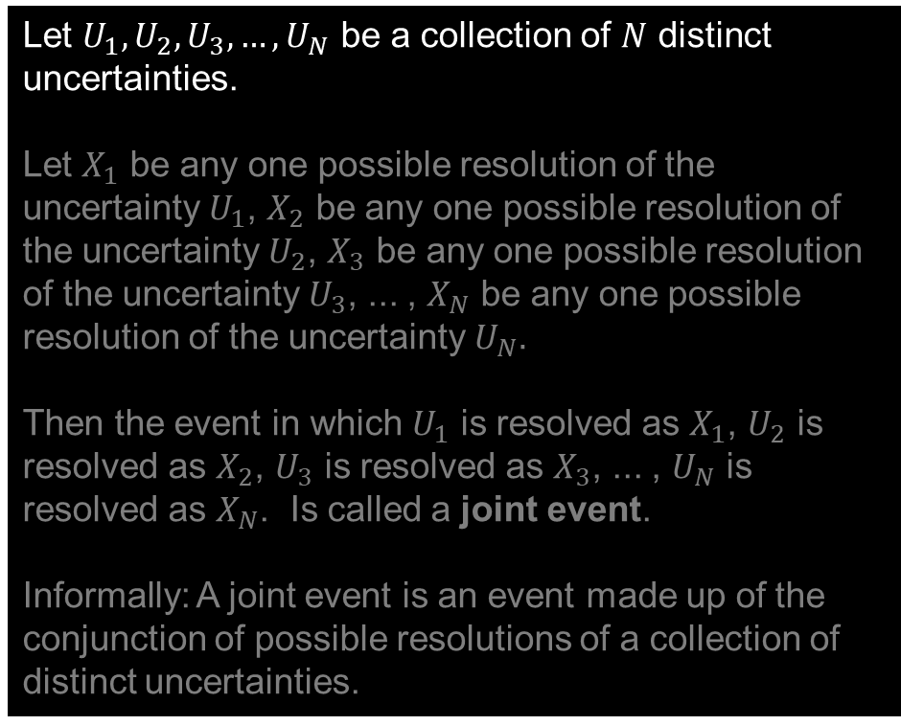
Joint Uncertainty, Joint Events, Joint Probabilities
TERMINOLOGY: Joint Event
Let $U_{1}, U_{2}, U_{3}, …, U_{N}$ be a collection of $N$ distinct uncertainties.
Let $X_{1}$ be any one possible resolution of the uncertainty $U_{1}$, $X_{2}$ be any one possible resolution of the uncertainty $U_{2}$, $X_{3}$ be any one possible resolution of the uncertainty $U_{3}$, ... , $X_{N}$ be any one possible resolution of the uncertainty $U_{N}.$
Then the event in which $U_{1}$ is resolved as $X_{1}$, $U_{2}$ is resolved as $X_{2}$, $U_{3}$ is resolved as $X_{3}$, ... , $U_{N}$ is resolved as $X_{N}$. Is called a joint event.
Informally: A joint event is an event made up of the conjunction of possible resolutions of a collection of distinct uncertainties.

Slide 53




Joint Uncertainty, Joint Events, Joint Probabilities
TERMINOLOGY: Joint Event
For example:
Let $U_{1}, U_{2}, U_{3}, …, U_{N}$ be a collection of $N$ distinct uncertainties.
Let $X_{1}$ be any one possible resolution of the uncertainty $U_{1}$, $X_{2}$ be any one possible resolution of the uncertainty $U_{2}$, $X_{3}$ be any one possible resolution of the uncertainty $U_{3}$, ... , $X_{N}$ be any one possible resolution of the uncertainty $U_{N}.$
Then the event in which $U_{1}$ is resolved as $X_{1}$, $U_{2}$ is resolved as $X_{2}$, $U_{3}$ is resolved as $X_{3}$, ... , $U_{N}$ is resolved as $X_{N}$. Is called a joint event.
Informally: A joint event is an event made up of the conjunction of possible resolutions of a collection of distinct uncertainties.
When is my grandmother’s birthday?
$U_{1}$:
Am I actually hungry? Or do I just need a nap?
$U_{2}$:
WTF does this have to do with politics?
$U_{3}$:
$U_{4}$:
Why am I taking this class?

Slide 54
Joint Uncertainty, Joint Events, Joint Probabilities
TERMINOLOGY: Joint Event
For example:
possible resolutions
Let $U_{1}, U_{2}, U_{3}, …, U_{N}$ be a collection of $N$ distinct uncertainties.
Let $X_{1}$ be any one possible resolution of the uncertainty $U_{1}$, $X_{2}$ be any one possible resolution of the uncertainty $U_{2}$, $X_{3}$ be any one possible resolution of the uncertainty $U_{3}$, ... , $X_{N}$ be any one possible resolution of the uncertainty $U_{N}.$
Then the event in which $U_{1}$ is resolved as $X_{1}$, $U_{2}$ is resolved as $X_{2}$, $U_{3}$ is resolved as $X_{3}$, ... , $U_{N}$ is resolved as $X_{N}$. Is called a joint event.
Informally: A joint event is an event made up of the conjunction of possible resolutions of a collection of distinct uncertainties.
When is my grandmother’s birthday?
$U_{1}$:
may 17
may 18
may 20
may 27
Am I actually hungry? Or do I just need a nap?
actually hungry
$U_{2}$:
just need a nap
both
neither
WTF does this have to do with politics?
absolutely nothing
very little
only that it’s a political science class
$U_{3}$:
Why am I taking this class?
I thought Stu was joking when he said is wasn’t useful for law school
$U_{4}$:
Masochism

Slide 55
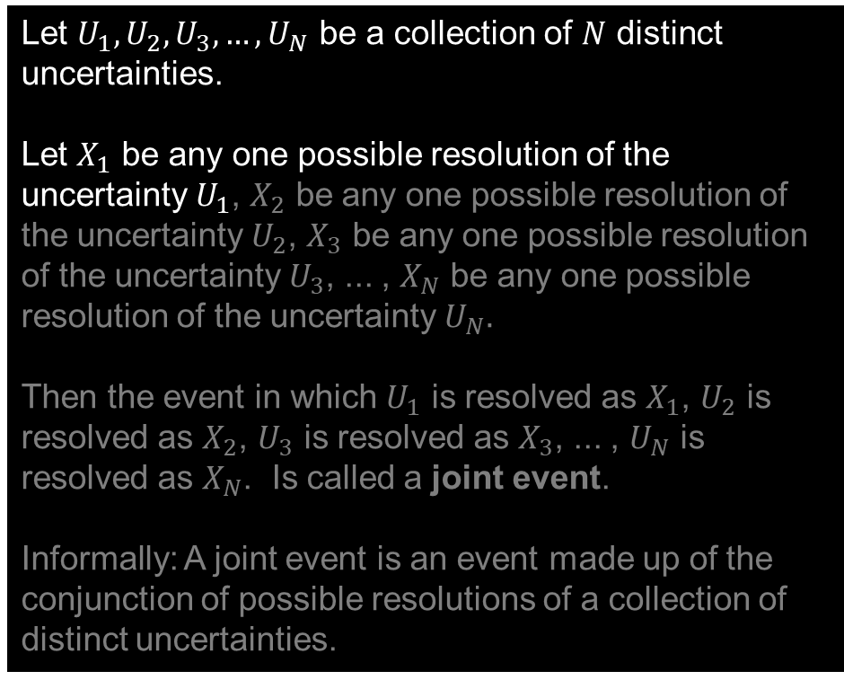
Joint Uncertainty, Joint Events, Joint Probabilities
TERMINOLOGY: Joint Event
For example:
possible resolutions
Let $U_{1}, U_{2}, U_{3}, …, U_{N}$ be a collection of $N$ distinct uncertainties.
Let $X_{1}$ be any one possible resolution of the uncertainty $U_{1}$, $X_{2}$ be any one possible resolution of the uncertainty $U_{2}$, $X_{3}$ be any one possible resolution of the uncertainty $U_{3}$, ... , $X_{N}$ be any one possible resolution of the uncertainty $U_{N}.$
Then the event in which $U_{1}$ is resolved as $X_{1}$, $U_{2}$ is resolved as $X_{2}$, $U_{3}$ is resolved as $X_{3}$, ... , $U_{N}$ is resolved as $X_{N}$. Is called a joint event.
Informally: A joint event is an event made up of the conjunction of possible resolutions of a collection of distinct uncertainties.
When is my grandmother’s birthday?
$U_{1}$:
may 17
may 18
may 20
may 27
Am I actually hungry? Or do I just need a nap?
actually hungry
$U_{2}$:
just need a nap
both
neither
WTF does this have to do with politics?
absolutely nothing
very little
only that it’s a political science class
$U_{3}$:
Why am I taking this class?
I thought Stu was joking when he said is wasn’t useful for law school
$U_{4}$:
Masochism

Slide 56
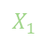
Joint Uncertainty, Joint Events, Joint Probabilities
TERMINOLOGY: Joint Event
For example:
possible resolutions
Let $U_{1}, U_{2}, U_{3}, …, U_{N}$ be a collection of $N$ distinct uncertainties.
Let $X_{1}$ be any one possible resolution of the uncertainty $U_{1}$, $X_{2}$ be any one possible resolution of the uncertainty $U_{2}$, $X_{3}$ be any one possible resolution of the uncertainty $U_{3}$, ... , $X_{N}$ be any one possible resolution of the uncertainty $U_{N}.$
Then the event in which $U_{1}$ is resolved as $X_{1}$, $U_{2}$ is resolved as $X_{2}$, $U_{3}$ is resolved as $X_{3}$, ... , $U_{N}$ is resolved as $X_{N}$. Is called a joint event.
Informally: A joint event is an event made up of the conjunction of possible resolutions of a collection of distinct uncertainties.
$$X_{1}$$
When is my grandmother’s birthday?
$U_{1}$:
may 17
may 18
may 20
may 27
Am I actually hungry? Or do I just need a nap?
actually hungry
$U_{2}$:
just need a nap
both
neither
WTF does this have to do with politics?
absolutely nothing
very little
only that it’s a political science class
$U_{3}$:
Why am I taking this class?
I thought Stu was joking when he said is wasn’t useful for law school
$U_{4}$:
Masochism

Slide 57
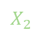
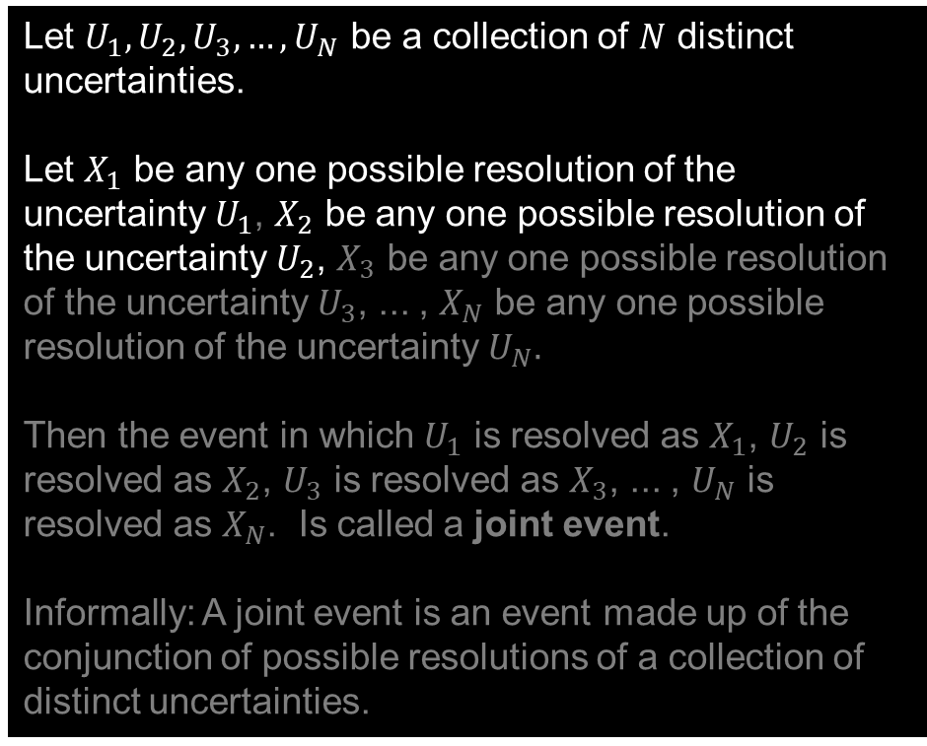
Joint Uncertainty, Joint Events, Joint Probabilities
TERMINOLOGY: Joint Event
For example:
possible resolutions
Let $U_{1}, U_{2}, U_{3}, …, U_{N}$ be a collection of $N$ distinct uncertainties.
Let $X_{1}$ be any one possible resolution of the uncertainty $U_{1}$, $X_{2}$ be any one possible resolution of the uncertainty $U_{2}$, $X_{3}$ be any one possible resolution of the uncertainty $U_{3}$, ... , $X_{N}$ be any one possible resolution of the uncertainty $U_{N}.$
Then the event in which $U_{1}$ is resolved as $X_{1}$, $U_{2}$ is resolved as $X_{2}$, $U_{3}$ is resolved as $X_{3}$, ... , $U_{N}$ is resolved as $X_{N}$. Is called a joint event.
Informally: A joint event is an event made up of the conjunction of possible resolutions of a collection of distinct uncertainties.
$$X_{1}$$
When is my grandmother’s birthday?
$U_{1}$:
may 17
may 18
may 20
may 27
Am I actually hungry? Or do I just need a nap?
$$X_{2}$$
$U_{2}$:
actually hungry
just need a nap
both
neither
WTF does this have to do with politics?
absolutely nothing
very little
only that it’s a political science class
$U_{3}$:
Why am I taking this class?
I thought Stu was joking when he said is wasn’t useful for law school
$U_{4}$:
Masochism

Slide 58
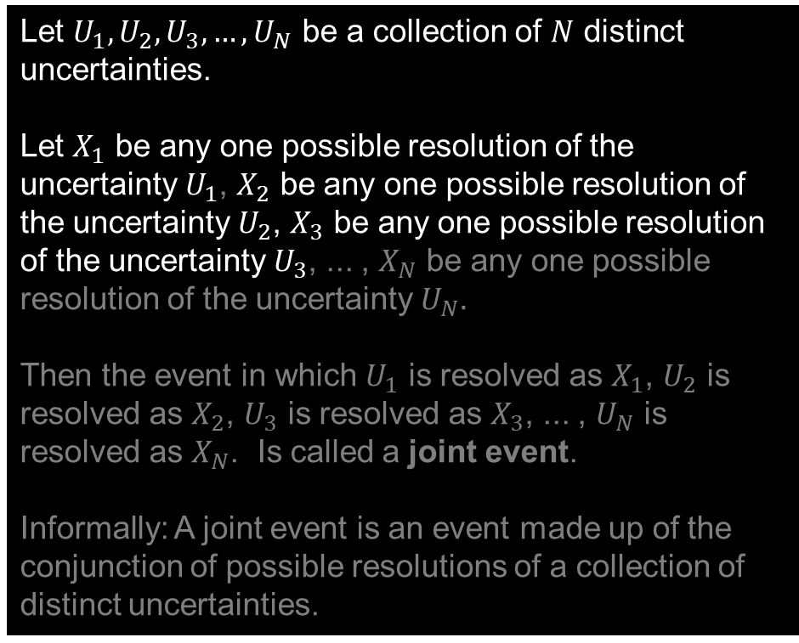
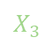
Joint Uncertainty, Joint Events, Joint Probabilities
TERMINOLOGY: Joint Event
For example:
possible resolutions
Let $U_{1}, U_{2}, U_{3}, …, U_{N}$ be a collection of $N$ distinct uncertainties.
Let $X_{1}$ be any one possible resolution of the uncertainty $U_{1}$, $X_{2}$ be any one possible resolution of the uncertainty $U_{2}$, $X_{3}$ be any one possible resolution of the uncertainty $U_{3}$, ... , $X_{N}$ be any one possible resolution of the uncertainty $U_{N}.$
Then the event in which $U_{1}$ is resolved as $X_{1}$, $U_{2}$ is resolved as $X_{2}$, $U_{3}$ is resolved as $X_{3}$, ... , $U_{N}$ is resolved as $X_{N}$. Is called a joint event.
Informally: A joint event is an event made up of the conjunction of possible resolutions of a collection of distinct uncertainties.
$$X_{1}$$
When is my grandmother’s birthday?
$U_{1}$:
may 17
may 18
may 20
may 27
Am I actually hungry? Or do I just need a nap?
$$X_{2}$$
$U_{2}$:
actually hungry
just need a nap
both
neither
$$X_{3}$$
WTF does this have to do with politics?
absolutely nothing
very little
only that it’s a political science class
$U_{3}$:
Why am I taking this class?
I thought Stu was joking when he said is wasn’t useful for law school
$U_{4}$:
Masochism

Slide 59
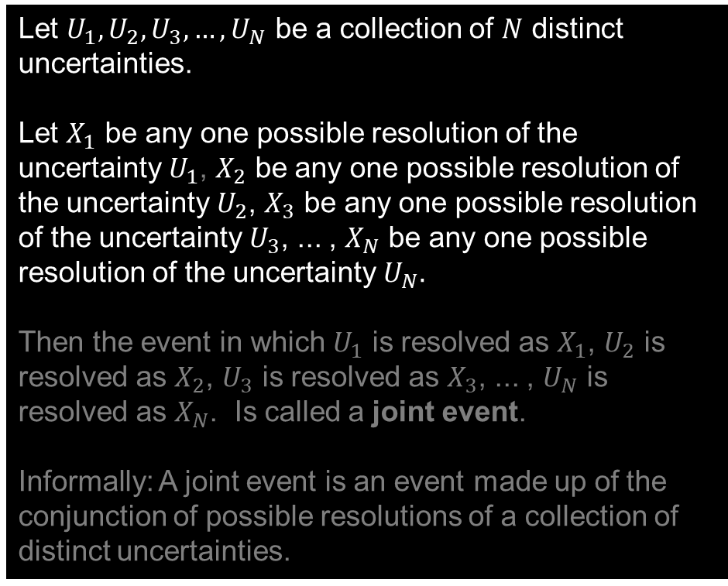
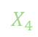
Joint Uncertainty, Joint Events, Joint Probabilities
TERMINOLOGY: Joint Event
For example:
possible resolutions
Let $U_{1}, U_{2}, U_{3}, …, U_{N}$ be a collection of $N$ distinct uncertainties.
Let $X_{1}$ be any one possible resolution of the uncertainty $U_{1}$, $X_{2}$ be any one possible resolution of the uncertainty $U_{2}$, $X_{3}$ be any one possible resolution of the uncertainty $U_{3}$, ... , $X_{N}$ be any one possible resolution of the uncertainty $U_{N}.$
Then the event in which $U_{1}$ is resolved as $X_{1}$, $U_{2}$ is resolved as $X_{2}$, $U_{3}$ is resolved as $X_{3}$, ... , $U_{N}$ is resolved as $X_{N}$. Is called a joint event.
Informally: A joint event is an event made up of the conjunction of possible resolutions of a collection of distinct uncertainties.
$$X_{1}$$
When is my grandmother’s birthday?
$U_{1}$:
may 17
may 18
may 20
may 27
Am I actually hungry? Or do I just need a nap?
$$X_{2}$$
$U_{2}$:
actually hungry
just need a nap
both
neither
$$X_{3}$$
WTF does this have to do with politics?
absolutely nothing
very little
only that it’s a political science class
$U_{3}$:
$$X_{4}$$
I thought Stu was joking when he said is wasn’t useful for law school
$U_{4}$:
Why am I taking this class?
Masochism

Slide 60
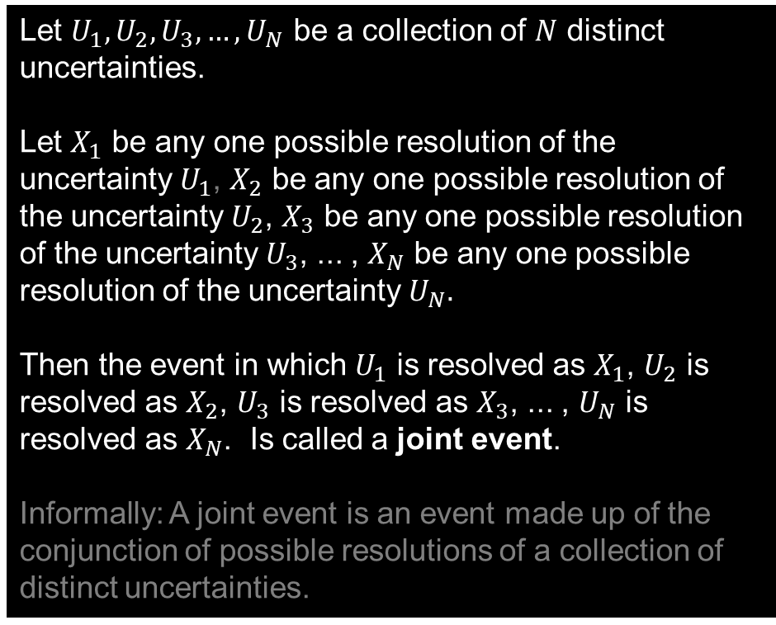
Joint Uncertainty, Joint Events, Joint Probabilities
TERMINOLOGY: Joint Event
For example:
possible resolutions
Let $U_{1}, U_{2}, U_{3}, …, U_{N}$ be a collection of $N$ distinct uncertainties.
Let $X_{1}$ be any one possible resolution of the uncertainty $U_{1}$, $X_{2}$ be any one possible resolution of the uncertainty $U_{2}$, $X_{3}$ be any one possible resolution of the uncertainty $U_{3}$, ... , $X_{N}$ be any one possible resolution of the uncertainty $U_{N}.$
Then the event in which $U_{1}$ is resolved as $X_{1}$, $U_{2}$ is resolved as $X_{2}$, $U_{3}$ is resolved as $X_{3}$, ... , $U_{N}$ is resolved as $X_{N}$. Is called a joint event.
Informally: A joint event is an event made up of the conjunction of possible resolutions of a collection of distinct uncertainties.
$$X_{1}$$
When is my grandmother’s birthday?
$U_{1}$:
may 17
may 18
may 20
may 27
Am I actually hungry? Or do I just need a nap?
$$X_{2}$$
$U_{2}$:
actually hungry
just need a nap
both
neither
$$X_{3}$$
WTF does this have to do with politics?
absolutely nothing
very little
only that it’s a political science class
$U_{3}$:
$$X_{4}$$
I thought Stu was joking when he said is wasn’t useful for law school
$U_{4}$:
Why am I taking this class?
Masochism

Slide 61
Joint Uncertainty, Joint Events, Joint Probabilities
TERMINOLOGY: Joint Event
For example:
possible resolutions
Let $U_{1}, U_{2}, U_{3}, …, U_{N}$ be a collection of $N$ distinct uncertainties.
Let $X_{1}$ be any one possible resolution of the uncertainty $U_{1}$, $X_{2}$ be any one possible resolution of the uncertainty $U_{2}$, $X_{3}$ be any one possible resolution of the uncertainty $U_{3}$, ... , $X_{N}$ be any one possible resolution of the uncertainty $U_{N}.$
Then the event in which $U_{1}$ is resolved as $X_{1}$, $U_{2}$ is resolved as $X_{2}$, $U_{3}$ is resolved as $X_{3}$, ... , $U_{N}$ is resolved as $X_{N}$. Is called a joint event.
Informally: A joint event is an event made up of the conjunction of possible resolutions of a collection of distinct uncertainties.
$$X_{1}$$
When is my grandmother’s birthday?
$U_{1}$:
may 17
may 18
may 20
may 27
Am I actually hungry? Or do I just need a nap?
$$X_{2}$$
$U_{2}$:
actually hungry
just need a nap
both
neither
$$X_{3}$$
WTF does this have to do with politics?
absolutely nothing
very little
only that it’s a political science class
$U_{3}$:
$$X_{4}$$
I thought Stu was joking when he said is wasn’t useful for law school
$U_{4}$:
Why am I taking this class?
Masochism
One Joint Event:
the only thing this class has to do with politics is that it’s taught in a political science class
I’m taking this class out of masochism
my grandmother’s birthday is May 17
&
I just need a nap
&
&

Slide 62
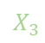
Joint Uncertainty, Joint Events, Joint Probabilities
TERMINOLOGY: Joint Event
For example:
possible resolutions
Let $U_{1}, U_{2}, U_{3}, …, U_{N}$ be a collection of $N$ distinct uncertainties.
Let $X_{1}$ be any one possible resolution of the uncertainty $U_{1}$, $X_{2}$ be any one possible resolution of the uncertainty $U_{2}$, $X_{3}$ be any one possible resolution of the uncertainty $U_{3}$, ... , $X_{N}$ be any one possible resolution of the uncertainty $U_{N}.$
Then the event in which $U_{1}$ is resolved as $X_{1}$, $U_{2}$ is resolved as $X_{2}$, $U_{3}$ is resolved as $X_{3}$, ... , $U_{N}$ is resolved as $X_{N}$. Is called a joint event.
Informally: A joint event is an event made up of the conjunction of possible resolutions of a collection of distinct uncertainties.
$$X_{1}$$
When is my grandmother’s birthday?
$U_{1}$:
may 17
may 18
may 20
may 27
Am I actually hungry? Or do I just need a nap?
$$X_{2}$$
$U_{2}$:
actually hungry
just need a nap
both
neither
WTF does this have to do with politics?
$$X_{3}$$
$U_{3}$:
absolutely nothing
very little
only that it’s a political science class
$$X_{4}$$
Why am I taking this class?
I thought Stu was joking when he said is wasn’t useful for law school
$U_{4}$:
Masochism
Another Joint Event:
I’m taking this class because I thought Stu was joking when he said is wasn’t useful for law school
my grandmother’s birthday is May 18
&
I’m hungry and I need a nap
&
this class has very little to do with politics
&

Slide 63
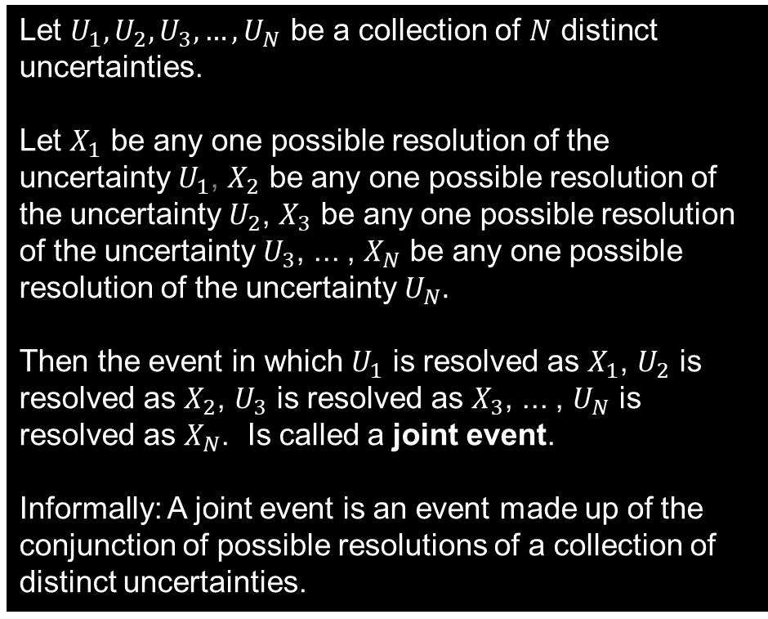
Joint Uncertainty, Joint Events, Joint Probabilities
TERMINOLOGY: Joint Event
For example:
possible resolutions
Let $U_{1}, U_{2}, U_{3}, …, U_{N}$ be a collection of $N$ distinct uncertainties.
Let $X_{1}$ be any one possible resolution of the uncertainty $U_{1}$, $X_{2}$ be any one possible resolution of the uncertainty $U_{2}$, $X_{3}$ be any one possible resolution of the uncertainty $U_{3}$, ... , $X_{N}$ be any one possible resolution of the uncertainty $U_{N}.$
Then the event in which $U_{1}$ is resolved as $X_{1}$, $U_{2}$ is resolved as $X_{2}$, $U_{3}$ is resolved as $X_{3}$, ... , $U_{N}$ is resolved as $X_{N}$. Is called a joint event.
Informally: A joint event is an event made up of the conjunction of possible resolutions of a collection of distinct uncertainties.
$$X_{1}$$
When is my grandmother’s birthday?
$U_{1}$:
may 17
may 18
may 20
may 27
Am I actually hungry? Or do I just need a nap?
$$X_{2}$$
$U_{2}$:
actually hungry
just need a nap
both
neither
$$X_{3}$$
WTF does this have to do with politics?
absolutely nothing
very little
only that it’s a political science class
$U_{3}$:
$$X_{4}$$
I thought Stu was joking when he said is wasn’t useful for law school
$U_{4}$:
Why am I taking this class?
Masochism
One Joint Event:
the only thing this class has to do with politics is that it’s taught in a political science class
I’m taking this class out of masochism
my grandmother’s birthday is May 17
&
I just need a nap
&
&

Slide 64
Joint Uncertainty, Joint Events, Joint Probabilities
Two Uncertainties
If the military attempts a coup, will it succeed?
If there is a war with an opposing military force, how well will the military perform in combat?
In a war, how well will the military perform?
poorly
moderately
excellently
EXAMPLE: The joint event in which an attempted coup will fail and the military will perform excellently in a war
succeed
If coup attempted, will it succeed?
fail

Slide 65
Joint Uncertainty, Joint Events, Joint Probabilities
Two Uncertainties
EXAMPLE: The joint event in which an attempted coup will succeed and the military will perform moderately in a war
If the military attempts a coup, will it succeed?
If there is a war with an opposing military force, how well will the military perform in combat?
In a war, how well will the military perform?
poorly
moderately
excellently
succeed
If coup attempted, will it succeed?
fail

Slide 66
Terminology and Notation
Relationships
Joint Event You should now have something in your notes for this!
Joint Probability
Marginal Uncertainty
Marginal Probability
Conditional Uncertainty
Conditional Probability
Joint Probability
Marginal Probability
Marginal Probability
Joint Probability
Conditional Probability

Slide 67
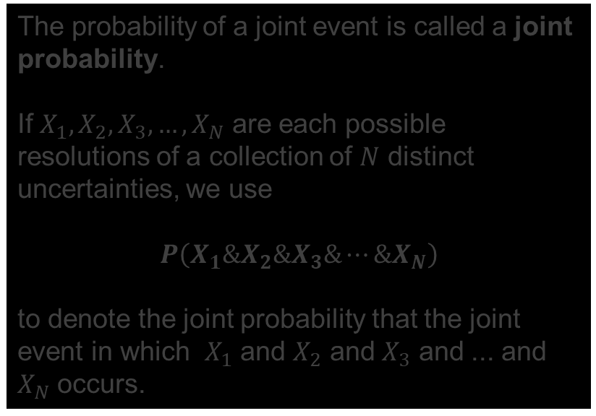
Joint Uncertainty, Joint Events, Joint Probabilities
TERMINOLOGY AND NOTATION: Joint Probability
The probability of a joint event is called a joint probability.
If $X_{1}, X_{2}, X_{3}, …, X_{N}$ are each possible resolutions of a collection of $N$ distinct uncertainties, we use
$$P\left(X_{1}\&X_{2}\&X_{3}\&⋯\&X_{N}\right)$$
to denote the joint probability that the joint event in which $X_{1}$ and $X_{2}$ and $X_{3}$ and ... and $X_{N}$ occurs.

Slide 68
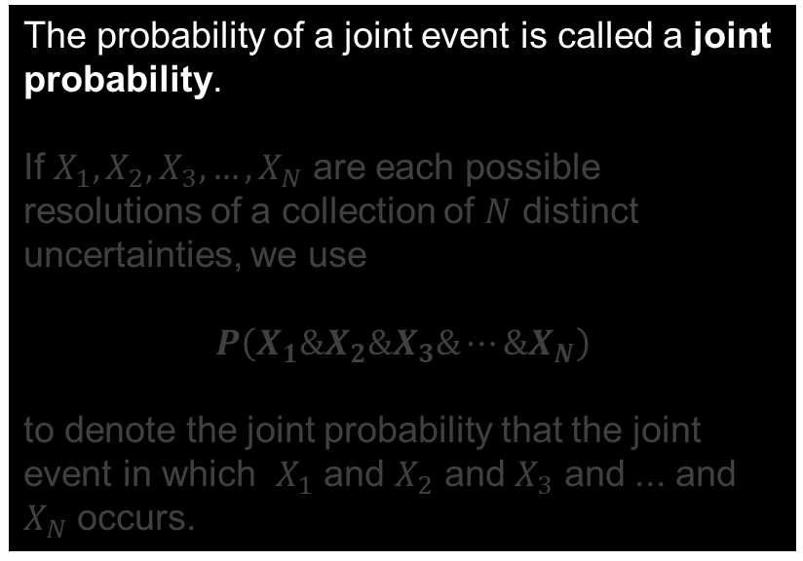
Joint Uncertainty, Joint Events, Joint Probabilities
TERMINOLOGY AND NOTATION: Joint Probability
The probability of a joint event is called a joint probability.
If $X_{1}, X_{2}, X_{3}, …, X_{N}$ are each possible resolutions of a collection of $N$ distinct uncertainties, we use
$$P\left(X_{1}\&X_{2}\&X_{3}\&⋯\&X_{N}\right)$$
to denote the joint probability that the joint event in which $X_{1}$ and $X_{2}$ and $X_{3}$ and ... and $X_{N}$ occurs.

Slide 69
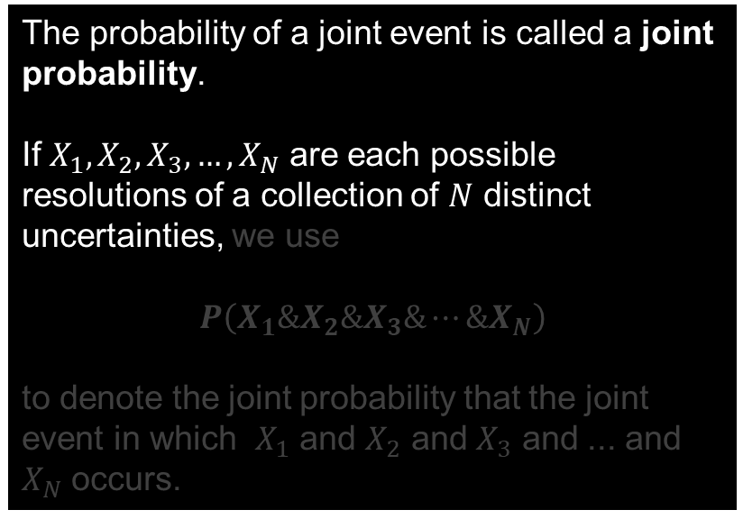
Joint Uncertainty, Joint Events, Joint Probabilities
TERMINOLOGY AND NOTATION: Joint Probability
The probability of a joint event is called a joint probability.
If $X_{1}, X_{2}, X_{3}, …, X_{N}$ are each possible resolutions of a collection of $N$ distinct uncertainties, we use
$$P\left(X_{1}\&X_{2}\&X_{3}\&⋯\&X_{N}\right)$$
to denote the joint probability that the joint event in which $X_{1}$ and $X_{2}$ and $X_{3}$ and ... and $X_{N}$ occurs.

Slide 70
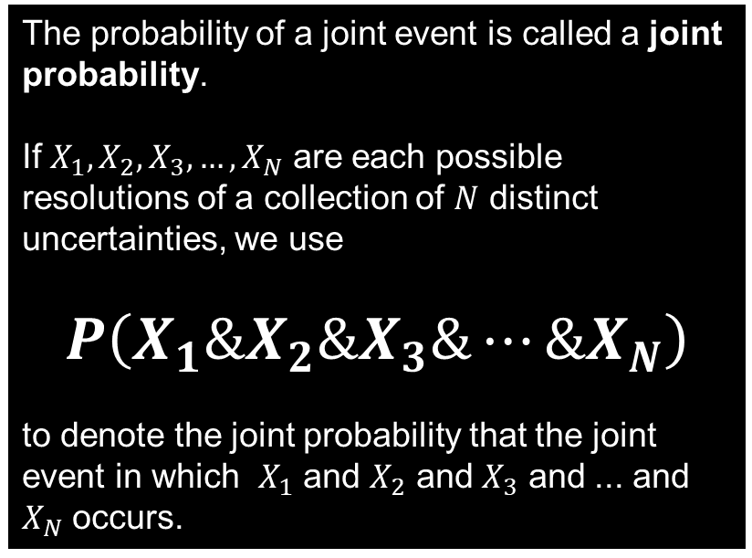
Joint Uncertainty, Joint Events, Joint Probabilities
TERMINOLOGY AND NOTATION: Joint Probability
The probability of a joint event is called a joint probability.
If $X_{1}, X_{2}, X_{3}, …, X_{N}$ are each possible resolutions of a collection of $N$ distinct uncertainties, we use
$$P\left(X_{1}\&X_{2}\&X_{3}\&⋯\&X_{N}\right)$$
to denote the joint probability that the joint event in which $X_{1}$ and $X_{2}$ and $X_{3}$ and ... and $X_{N}$ occurs.

Slide 71
Joint Uncertainty, Joint Events, Joint Probabilities
TERMINOLOGY AND NOTATION: Joint Probability
For example:
possible resolutions
The probability of a joint event is called a joint probability.
If $X_{1}, X_{2}, X_{3}, …, X_{N}$ are each possible resolutions of a collection of $N$ distinct uncertainties, we use
$$P\left(X_{1}\&X_{2}\&X_{3}\&⋯\&X_{N}\right)$$
to denote the joint probability that the joint event in which $X_{1}$ and $X_{2}$ and $X_{3}$ and ... and $X_{N}$ occurs.
When is my grandmother’s birthday?
$$X_{1}$$
$U_{1}$:
may 17
may 18
may 20
may 27
Am I actually hungry? Or do I just need a nap?
$$X_{2}$$
$U_{2}$:
actually hungry
just need a nap
both
neither
$$X_{3}$$
WTF does this have to do with politics?
absolutely nothing
very little
only that it’s a political science class
$U_{3}$:
$$X_{4}$$
I thought Stu was joking when he said is wasn’t useful for law school
$U_{4}$:
Why am I taking this class?
Masochism
One Joint Event:
my grandmother’s birthday is May 17
I just need a nap
this has very little to do with politcs
I’m taking this class out of masochism
&
&
&

Slide 72
Joint Uncertainty, Joint Events, Joint Probabilities
TERMINOLOGY AND NOTATION: Joint Probability
For example:
possible resolutions
The probability of a joint event is called a joint probability.
If $X_{1}, X_{2}, X_{3}, …, X_{N}$ are each possible resolutions of a collection of $N$ distinct uncertainties, we use
$$P\left(X_{1}\&X_{2}\&X_{3}\&⋯\&X_{N}\right)$$
to denote the joint probability that the joint event in which $X_{1}$ and $X_{2}$ and $X_{3}$ and ... and $X_{N}$ occurs.
When is my grandmother’s birthday?
$$X_{1}$$
$U_{1}$:
may 17
may 18
may 20
may 27
Am I actually hungry? Or do I just need a nap?
$$X_{2}$$
$U_{2}$:
actually hungry
just need a nap
both
neither
$$X_{3}$$
WTF does this have to do with politics?
absolutely nothing
very little
only that it’s a political science class
$U_{3}$:
$$X_{4}$$
I thought Stu was joking when he said is wasn’t useful for law school
$U_{4}$:
Why am I taking this class?
Masochism
Probability of That Joint Event:
(
)
P
this has very little to do with politcs
I’m taking this class out of masochism
my grandmother’s birthday is May 17
&
I just need a nap
&
&

Slide 73
Joint Uncertainty, Joint Events, Joint Probabilities
Two Uncertainties
If the military attempts a coup, will it succeed?
If there is a war with an opposing military force, how well will the military perform in combat?
In a war, how well will the military perform?
poorly
moderately
excellently
succeed
If coup attempted, will it succeed?
fail

Slide 74






Joint Uncertainty, Joint Events, Joint Probabilities
Two Uncertainties
If the military attempts a coup, will it succeed?
If there is a war with an opposing military force, how well will the military perform in combat?
In a war, how well will the military perform?
poorly
moderately
excellently
succeed
$$P(\text{succeed} \& \text{poorly})$$
$$P(\text{succeed} \& \text{moderately})$$
$$P(\text{succeed} \& \text{excellently})$$
If coup attempted, will it succeed?
fail
$$P(\text{fail} \& \text{poorly})$$
$$P(\text{fail} \& \text{moderately})$$
$$P(\text{fail} \& \text{excellently})$$

Slide 75
Terminology and Notation
Relationships
Joint Event You should now have something in your notes for this!
Joint Probability You should now have something in your notes for this!
Marginal Uncertainty
Marginal Probability
Conditional Uncertainty
Conditional Probability
Joint Probability
Marginal Probability
Marginal Probability
Joint Probability
Conditional Probability

Slide 76
Joint Uncertainty, Joint Events, Joint Probabilities
Remember: In every probabilistic model, the probabilities assigned to the exhaustive list of mutually exclusive events must sum to 1.
Two Uncertainties
If the military attempts a coup, will it succeed?
If there is a war with an opposing military force, how well will the military perform in combat?
In a war, how well will the military perform?
poorly
moderately
excellently
succeed
$$P(\text{succeed} \& \text{poorly})$$
$$P(\text{succeed} \& \text{moderately})$$
$$P(\text{succeed} \& \text{excellently})$$
If coup attempted, will it succeed?
fail
$$P(\text{fail} \& \text{poorly})$$
$$P(\text{fail} \& \text{moderately})$$
$$P(\text{fail} \& \text{excellently})$$

Slide 77
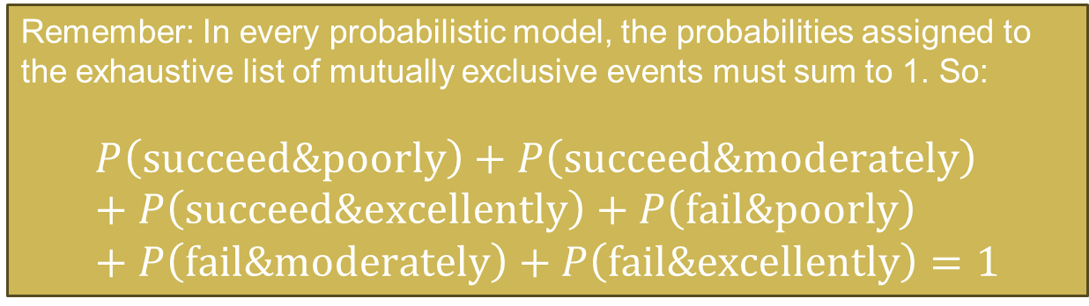
Joint Uncertainty, Joint Events, Joint Probabilities
Remember: In every probabilistic model, the probabilities assigned to the exhaustive list of mutually exclusive events must sum to 1. So:
$$P\left(\text{succeed}\text{\&}\text{poorly}\right)+P\left(\text{succeed}\text{\&}\text{moderately}\right)+P\left(\text{succeed}\text{\&}\text{excellently}\right)+P\left(\text{fail}\text{\&}\text{poorly}\right)+P\left(\text{fail}\text{\&}\text{moderately}\right)+P\left(\text{fail}\text{\&}\text{excellently}\right)=1$$
Two Uncertainties
If the military attempts a coup, will it succeed?
If there is a war with an opposing military force, how well will the military perform in combat?
In a war, how well will the military perform?
poorly
moderately
excellently
succeed
$$P(\text{succeed} \& \text{poorly})$$
$$P(\text{succeed} \& \text{moderately})$$
$$P(\text{succeed} \& \text{excellently})$$
If coup attempted, will it succeed?
fail
$$P(\text{fail} \& \text{poorly})$$
$$P(\text{fail} \& \text{moderately})$$
$$P(\text{fail} \& \text{excellently})$$

Slide 78

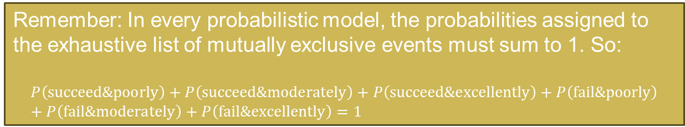





Joint Uncertainty, Joint Events, Joint Probabilities
Remember: In every probabilistic model, the probabilities assigned to the exhaustive list of mutually exclusive events must sum to 1. So:
$$P\left(\text{succeed}\text{\&}\text{poorly}\right)+P\left(\text{succeed}\text{\&}\text{moderately}\right)+P\left(\text{succeed}\text{\&}\text{excellently}\right)+P\left(\text{fail}\text{\&}\text{poorly}\right)+P\left(\text{fail}\text{\&}\text{moderately}\right)+P\left(\text{fail}\text{\&}\text{excellently}\right)=1$$
Remember: In every probabilistic model, the probabilities assigned to the exhaustive list of mutually exclusive events must sum to 1. So:
$$P\left(\text{succeed}\text{\&}\text{poorly}\right)+P\left(\text{succeed}\text{\&}\text{moderately}\right)+P\left(\text{succeed}\text{\&}\text{excellently}\right)+P\left(\text{fail}\text{\&}\text{poorly}\right)+P\left(\text{fail}\text{\&}\text{moderately}\right)+P\left(\text{fail}\text{\&}\text{excellently}\right)=1$$
Two Uncertainties
If the military attempts a coup, will it succeed?
If there is a war with an opposing military force, how well will the military perform in combat?
In a war, how well will the military perform?
poorly
moderately
excellently
For Example
succeed
$$\frac{1}{10}$$
$$\frac{5}{10}$$
$$0$$
If coup attempted, will it succeed?
fail
$$\frac{3}{10}$$
$$0$$
$$\frac{1}{10}$$

Slide 79
Joint Uncertainty, Joint Events, Joint Probabilities
TRY IT
Imagine the mayor of a city trying to decide how big of a budget to give to his department of sanitation.
Suppose that for any given size of the budget, the mayor is uncertain about two things:
How much independent political power will the Commissioner of Sanitation amass by selectively handing out contracts?
How satisfied will city resident’s be with the cleanliness of the city’s streets and sidewalks?
Build a model of the mayor’s uncertainty about these two issues (without assigning probabilities...we’re getting to that!), and draw a grid to display your model. Assign specific numerical values for the probability of each joint event to the appropriate cell.

Slide 80
Joint Uncertainty, Joint Events, Joint Probabilities
TRY IT
Imagine the mayor of a city trying to decide how big of a budget to give to his department of sanitation.
Suppose that for any given size of the budget, the mayor is uncertain about two things:
How much independent political power will the Commissioner of Sanitation amass by selectively handing out contracts?
How satisfied will city resident’s be with the cleanliness of the city’s streets and sidewalks?
Build a model of the mayor’s uncertainty about these two issues (without assigning probabilities...we’re getting to that!), and draw a grid to display your model. Assign specific numerical values for the probability of each joint event to the appropriate cell.
how much political power will the commissioner amass?
none
some
a lot
completely
how satisfied will residents be?
moderately
not at all

Slide 81









Joint Uncertainty, Joint Events, Joint Probabilities
TRY IT
Imagine the mayor of a city trying to decide how big of a budget to give to his department of sanitation.
Suppose that for any given size of the budget, the mayor is uncertain about two things:
How much independent political power will the Commissioner of Sanitation amass by selectively handing out contracts?
How satisfied will city resident’s be with the cleanliness of the city’s streets and sidewalks?
Build a model of the mayor’s uncertainty about these two issues (without assigning probabilities...we’re getting to that!), and draw a grid to display your model. Assign specific numerical values for the probability of each joint event to the appropriate cell.
how much political power will the commissioner amass?
none
some
a lot
completely
$$\frac{1}{18}$$
$$\frac{2}{18}$$
$$\frac{3}{18}$$
how satisfied will residents be?
$$\frac{1}{18}$$
$$\frac{1}{18}$$
$$\frac{1}{18}$$
moderately
$$\frac{5}{18}$$
$$0$$
$$\frac{4}{18}$$
not at all

Slide 82

Motivation & Example – the Guardianship Dilemma
Joint Uncertainty, Joint Events, Joint Probability
Marginal Uncertainty, Marginal Probability
Conditional Uncertainty, Conditional Probability
The Marginal-Conditional Method of Modeling Joint Uncertainty
z

Slide 83
Marginal Uncertainty, Marginal Probability
In a war, how well will the military perform?
poorly
moderately
excellently
succeed
If coup attempted, will it succeed?
fail

Slide 84
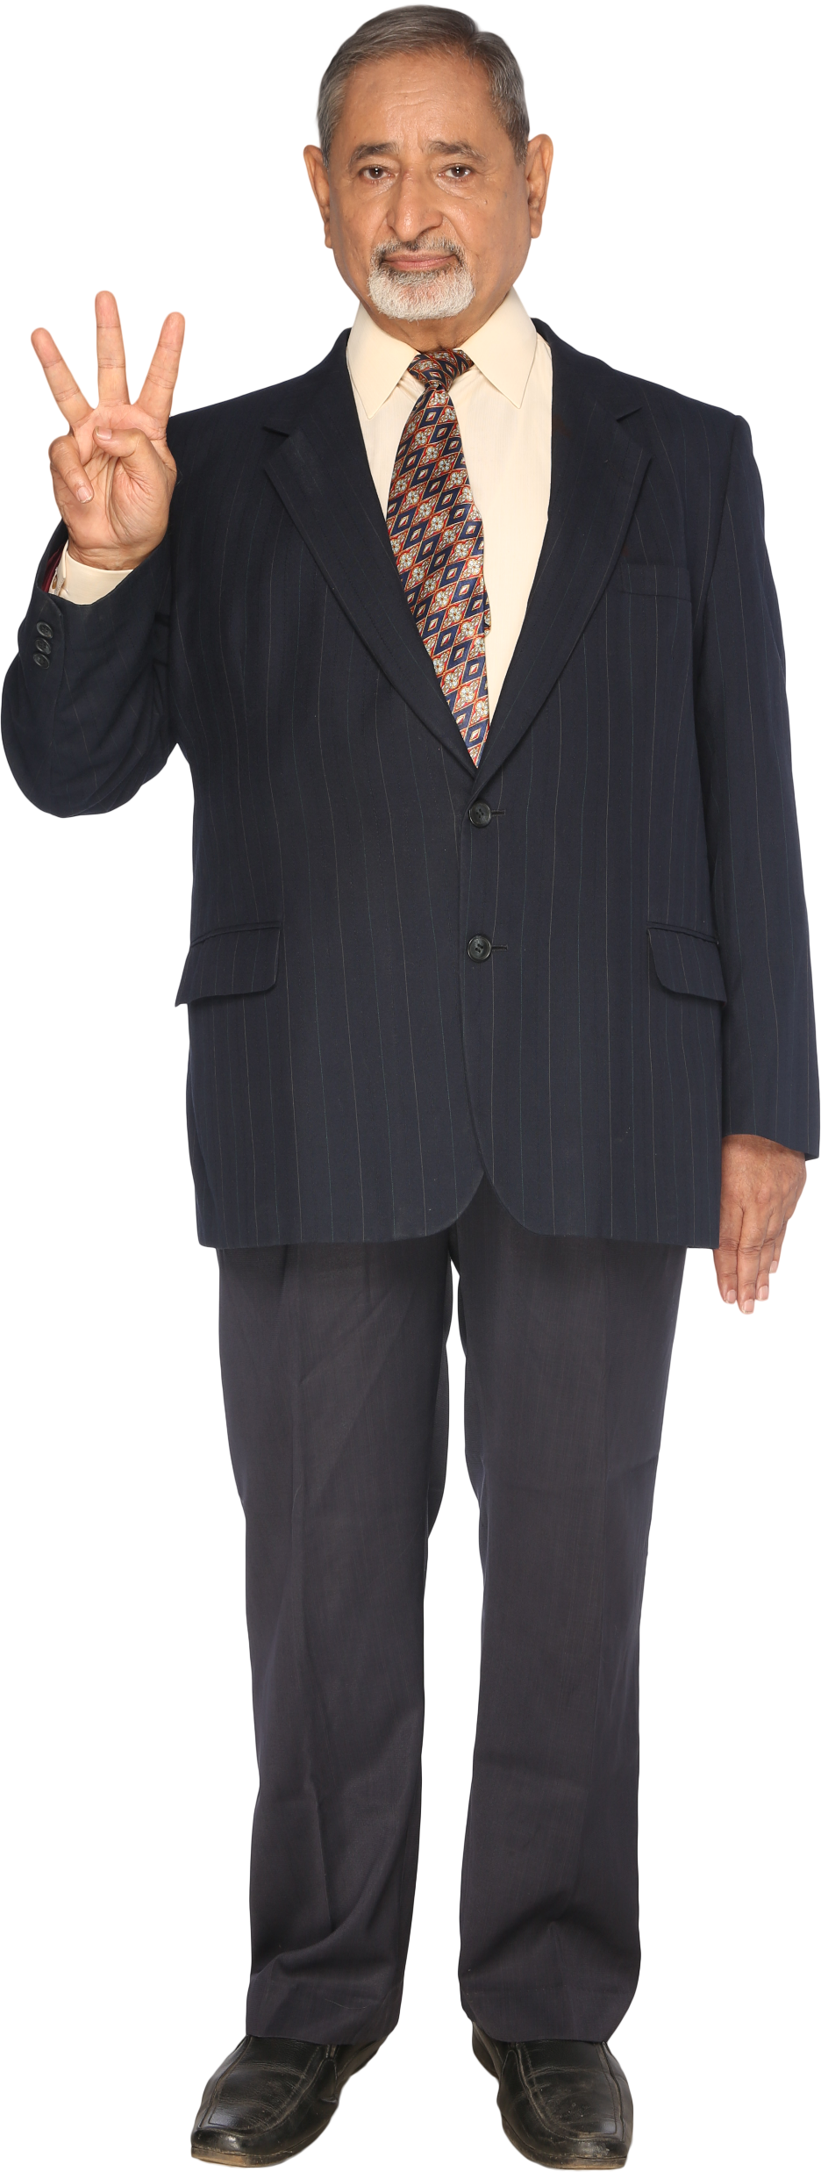
Marginal Uncertainty, Marginal Probability
In a war, how well will the military perform?
poorly
moderately
excellently
succeed
If coup attempted, will it succeed?
fail

Slide 85
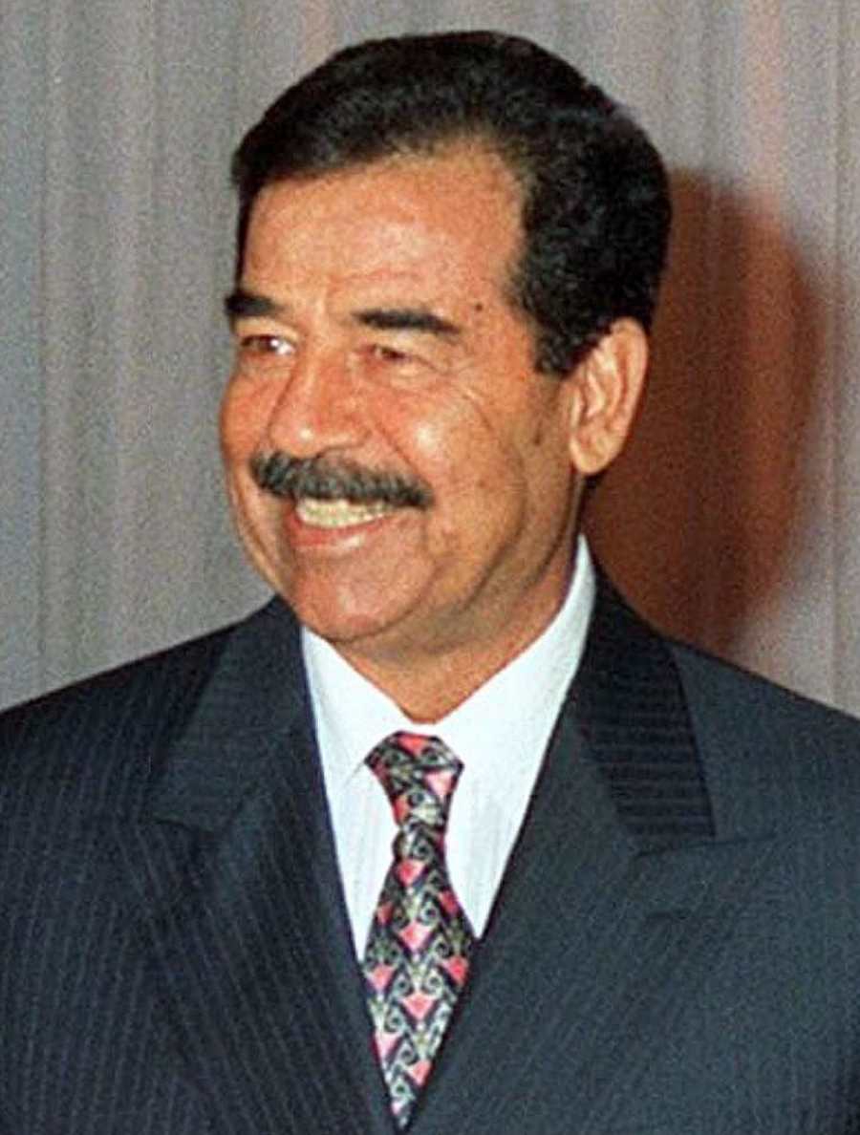
Marginal Uncertainty, Marginal Probability
In a war, how well will the military perform?
poorly
moderately
excellently
succeed
If coup attempted, will it succeed?
fail
chief executive

Slide 86

Marginal Uncertainty, Marginal Probability
In a war, how well will the military perform?
poorly
moderately
excellently
succeed
If coup attempted, will it succeed?
fail
chief executive

Slide 87
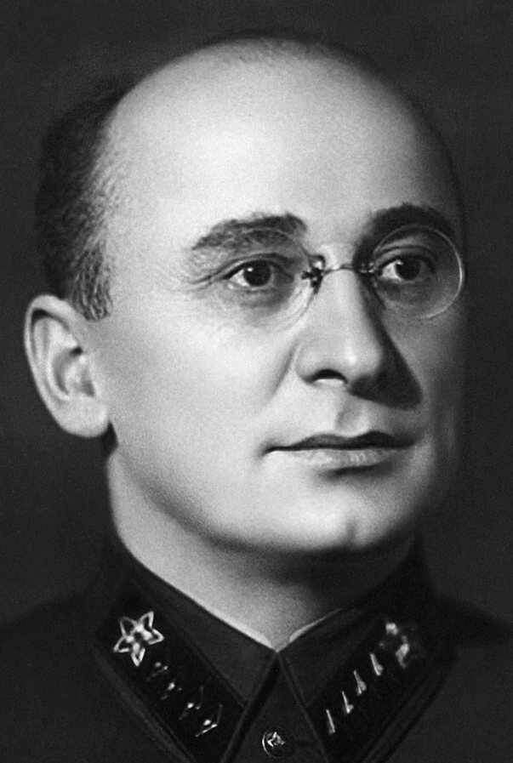
Marginal Uncertainty, Marginal Probability
In a war, how well will the military perform?
poorly
moderately
excellently
succeed
If coup attempted, will it succeed?
fail
head of internal security bureau
chief executive

Slide 88

Marginal Uncertainty, Marginal Probability
In a war, how well will the military perform?
How’s it going?
poorly
moderately
excellently
succeed
If coup attempted, will it succeed?
fail
head of internal security bureau
chief executive

Slide 89
Marginal Uncertainty, Marginal Probability
In a war, how well will the military perform?
Terrible. I couldn’t sleep last night
poorly
moderately
excellently
succeed
If coup attempted, will it succeed?
fail
head of internal security bureau
chief executive

Slide 90
Marginal Uncertainty, Marginal Probability
I think the neighboring country is going to invade us, and I’m worried the military might perform poorly in a war
In a war, how well will the military perform?
poorly
moderately
excellently
succeed
If coup attempted, will it succeed?
fail
head of internal security bureau
chief executive

Slide 91
Marginal Uncertainty, Marginal Probability
Beria, you ignorant %&@#$#@%!
In a war, how well will the military perform?
poorly
moderately
excellently
succeed
If coup attempted, will it succeed?
fail
head of internal security bureau
chief executive

Slide 92
Marginal Uncertainty, Marginal Probability
There’s only ONE THING you should be worrying about.
In a war, how well will the military perform?
poorly
moderately
excellently
succeed
If coup attempted, will it succeed?
fail
head of internal security bureau
chief executive

Slide 93
Marginal Uncertainty, Marginal Probability
And that’s whether I’m going to get deposed in a coup.
In a war, how well will the military perform?
poorly
moderately
excellently
succeed
If coup attempted, will it succeed?
fail
head of internal security bureau
chief executive

Slide 94
Marginal Uncertainty, Marginal Probability
In a war, how well will the military perform?
poorly
moderately
excellently
succeed
If coup attempted, will it succeed?
fail

Slide 95
Marginal Uncertainty, Marginal Probability
In a war, how well will the military perform?
poorly
moderately
excellently
The head of internal security and the chief executive are each uncertain about two things...
succeed
If coup attempted, will it succeed?
fail

Slide 96

Marginal Uncertainty, Marginal Probability
In a war, how well will the military perform?
poorly
moderately
excellently
The head of internal security and the chief executive are each uncertain about two things...
succeed
In effect, they’re uncertain about which cell correctly describes their situation.
If coup attempted, will it succeed?
fail

Slide 97
Marginal Uncertainty, Marginal Probability
In a war, how well will the military perform?
poorly
moderately
excellently
The head of internal security and the chief executive are each uncertain about two things...
succeed
In effect, they’re uncertain about which cell correctly describes their situation.
If coup attempted, will it succeed?
But the chief executive says that the head of internal security’s job is to worry ONLY ABOUT ONE of the two uncertainties.
fail

Slide 98


Marginal Uncertainty, Marginal Probability
In a war, how well will the military perform?
poorly
moderately
excellently
The head of internal security and the chief executive are each uncertain about two things...
succeed
In effect, they’re uncertain about which cell correctly describes their situation.
If coup attempted, will it succeed?
But the chief executive says that the head of internal security’s job is to worry ONLY ABOUT ONE of the two uncertainties.
fail
In effect, the chief executive wants the head of internal security to ONLY wonder WHICH ROW contains the cell that correctly describes their situation.

Slide 99
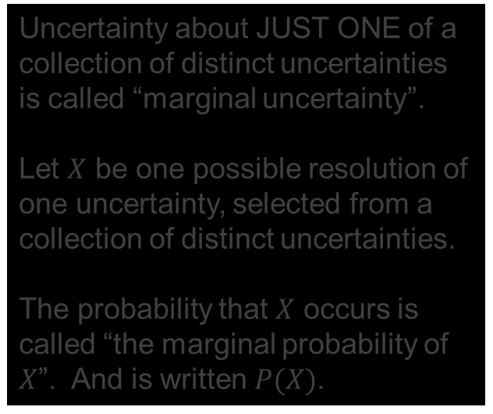
Marginal Uncertainty, Marginal Probability
In a war, how well will the military perform?
TERMINOLOGY AND NOTATION: Marginal Uncertainty, Marginal Probability
poorly
moderately
excellently
Uncertainty about JUST ONE of a collection of distinct uncertainties is called “marginal uncertainty”.
Let $X$ be one possible resolution of one uncertainty, selected from a collection of distinct uncertainties.
The probability that $X$ occurs is called “the marginal probability of $X$”. And is written $P(X)$.
succeed
If coup attempted, will it succeed?
fail

Slide 100
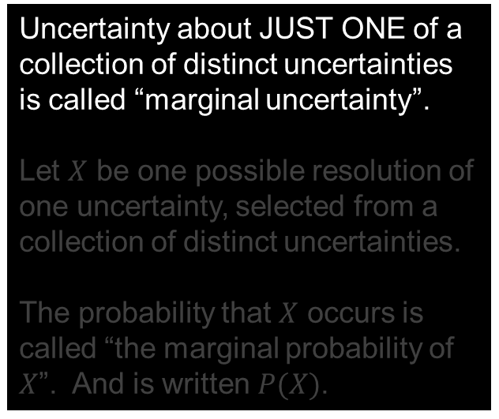
Marginal Uncertainty, Marginal Probability
In a war, how well will the military perform?
TERMINOLOGY AND NOTATION: Marginal Uncertainty, Marginal Probability
poorly
moderately
excellently
Uncertainty about JUST ONE of a collection of distinct uncertainties is called “marginal uncertainty”.
Let $X$ be one possible resolution of one uncertainty, selected from a collection of distinct uncertainties.
The probability that $X$ occurs is called “the marginal probability of $X$”. And is written $P(X)$.
succeed
If coup attempted, will it succeed?
fail

Slide 101
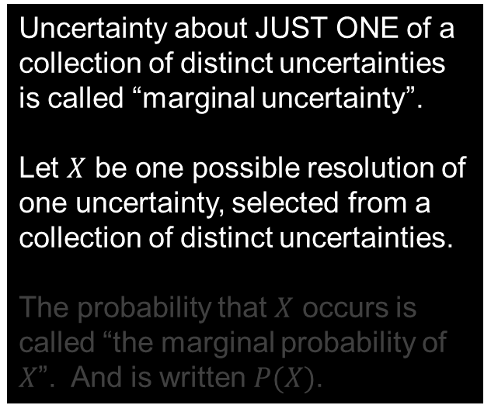
Marginal Uncertainty, Marginal Probability
In a war, how well will the military perform?
TERMINOLOGY AND NOTATION: Marginal Uncertainty, Marginal Probability
poorly
moderately
excellently
Uncertainty about JUST ONE of a collection of distinct uncertainties is called “marginal uncertainty”.
Let $X$ be one possible resolution of one uncertainty, selected from a collection of distinct uncertainties.
The probability that $X$ occurs is called “the marginal probability of $X$”. And is written $P(X)$.
succeed
If coup attempted, will it succeed?
fail

Slide 102
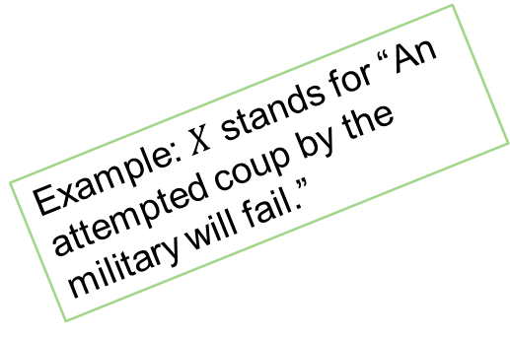

Marginal Uncertainty, Marginal Probability
In a war, how well will the military perform?
TERMINOLOGY AND NOTATION: Marginal Uncertainty, Marginal Probability
poorly
moderately
excellently
Uncertainty about JUST ONE of a collection of distinct uncertainties is called “marginal uncertainty”.
Let $X$ be one possible resolution of one uncertainty, selected from a collection of distinct uncertainties.
The probability that $X$ occurs is called “the marginal probability of $X$”. And is written $P(X)$.
succeed
If coup attempted, will it succeed?
fail
Example: $X$ stands for “An attempted coup by the military will fail.”

Slide 103
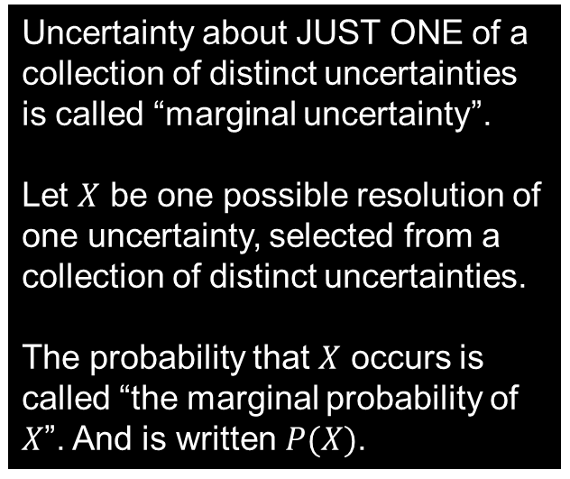
Marginal Uncertainty, Marginal Probability
In a war, how well will the military perform?
TERMINOLOGY AND NOTATION: Marginal Uncertainty, Marginal Probability
poorly
moderately
excellently
Uncertainty about JUST ONE of a collection of distinct uncertainties is called “marginal uncertainty”.
Let $X$ be one possible resolution of one uncertainty, selected from a collection of distinct uncertainties.
The probability that $X$ occurs is called “the marginal probability of $X$”. And is written $P(X)$.
succeed
If coup attempted, will it succeed?
fail
Example: $X$ stands for “An attempted coup by the military will fail.”

Slide 104
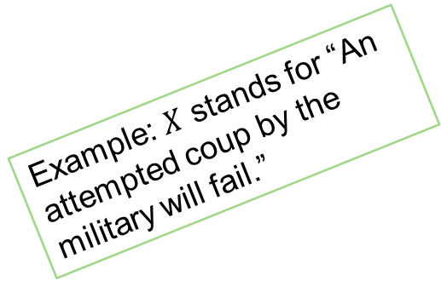

Marginal Uncertainty, Marginal Probability
In a war, how well will the military perform?
TERMINOLOGY AND NOTATION: Marginal Uncertainty, Marginal Probability
poorly
moderately
excellently
Uncertainty about JUST ONE of a collection of distinct uncertainties is called “marginal uncertainty”.
Let $X$ be one possible resolution of one uncertainty, selected from a collection of distinct uncertainties.
The probability that $X$ occurs is called “the marginal probability of $X$”. And is written $P(X)$.
succeed
If coup attempted, will it succeed?
$$P(\text{fail})$$
fail
Example: $X$ stands for “An attempted coup by the military will fail.”

Slide 105
Terminology and Notation
Relationships
Joint Event You should now have something in your notes for this!
Joint Probability You should now have something in your notes for this!
Marginal Uncertainty You should now have something in your notes for this!
Marginal Probability You should now have something in your notes for this!
Conditional Uncertainty
Conditional Probability
Joint Probability
Marginal Probability
Marginal Probability
Joint Probability
Conditional Probability

Slide 106


Marginal Uncertainty, Marginal Probability
In a war, how well will the military perform?
Modeling Marginal Uncertainty
poorly
moderately
excellently
succeed
$$P(\text{succeed})$$
If coup attempted, will it succeed?
$$P(\text{fail})$$
fail

Slide 107
Marginal Uncertainty, Marginal Probability
In a war, how well will the military perform?
Modeling Marginal Uncertainty
poorly
moderately
excellently
TRUE or FALSE?
“Succeed” and “fail” together make up the exhaustive list of mutually exclusive resolutions of the marginal uncertainty about whether an attempted coup would succeed or fail.
succeed
$$P(\text{succeed})$$
If coup attempted, will it succeed?
$$P(\text{fail})$$
fail

Slide 108
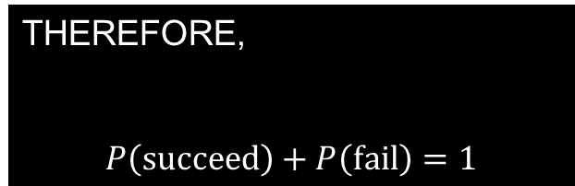
Marginal Uncertainty, Marginal Probability
In a war, how well will the military perform?
Modeling Marginal Uncertainty
poorly
moderately
excellently
TRUE or FALSE?
“Succeed” and “fail” together make up the exhaustive list of mutually exclusive resolutions of the marginal uncertainty about whether an attempted coup would succeed or fail.
succeed
$$P(\text{succeed})$$
If coup attempted, will it succeed?
$$P(\text{fail})$$
TRUE!!!!
fail
THEREFORE,
$$P\left(\text{succeed}\right)+P\left(\text{fail}\right)=1$$

Slide 109

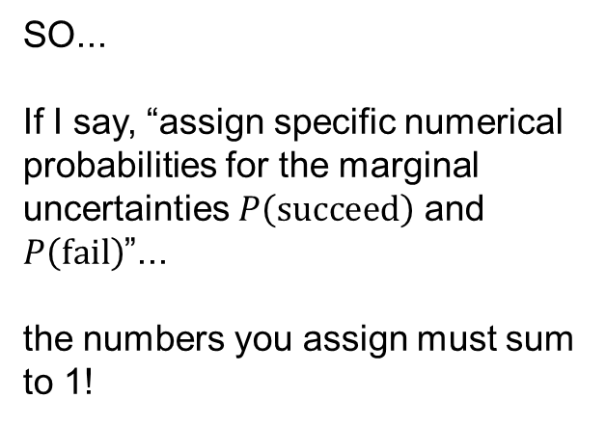
Marginal Uncertainty, Marginal Probability
In a war, how well will the military perform?
Modeling Marginal Uncertainty
poorly
moderately
excellently
SO...
If I say, “assign specific numerical probabilities for the marginal uncertainties $P\left(\text{succeed}\right)$ and $P\left(\text{fail}\right)$”...
the numbers you assign must sum to 1!
succeed
$$P(\text{succeed})$$
If coup attempted, will it succeed?
$$P(\text{fail})$$
fail
$$P\left(\text{succeed}\right)+P\left(\text{fail}\right)=1$$

Slide 110


Marginal Uncertainty, Marginal Probability
In a war, how well will the military perform?
Modeling Marginal Uncertainty
poorly
moderately
excellently
SO...
If I say, “assign specific numerical probabilities for the marginal uncertainties $P\left(\text{succeed}\right)$ and $P\left(\text{fail}\right)$”...
the numbers you assign must sum to 1!
Examples
succeed
$$\frac{3}{4}$$
If coup attempted, will it succeed?
$$\frac{1}{4}$$
fail
$$P\left(\text{succeed}\right)+P\left(\text{fail}\right)=1$$

Slide 111


Marginal Uncertainty, Marginal Probability
In a war, how well will the military perform?
Modeling Marginal Uncertainty
poorly
moderately
excellently
SO...
If I say, “assign specific numerical probabilities for the marginal uncertainties $P\left(\text{succeed}\right)$ and $P\left(\text{fail}\right)$”...
the numbers you assign must sum to 1!
Examples
succeed
$$\frac{1}{10}$$
If coup attempted, will it succeed?
$$\frac{9}{10}$$
fail
$$P\left(\text{succeed}\right)+P\left(\text{fail}\right)=1$$

Slide 112


Marginal Uncertainty, Marginal Probability
In a war, how well will the military perform?
Modeling Marginal Uncertainty
poorly
moderately
excellently
SO...
If I say, “assign specific numerical probabilities for the marginal uncertainties $P\left(\text{succeed}\right)$ and $P\left(\text{fail}\right)$”...
the numbers you assign must sum to 1!
succeed
$$\frac{3}{465}$$
If coup attempted, will it succeed?
$$\frac{462}{465}$$
fail
$$P\left(\text{succeed}\right)+P\left(\text{fail}\right)=1$$

Slide 113
Marginal Uncertainty, Marginal Probability
In a war, how well will the military perform?
TRY IT
poorly
moderately
excellently
Assign specific numerical values to model the marginal uncertainty about how well the military will perform in a war with a foreign adversary.
succeed
If coup attempted, will it succeed?
fail

Slide 114

Marginal Uncertainty, Marginal Probability
In a war, how well will the military perform?
TRY IT
poorly
moderately
excellently
Assign specific numerical values to model the marginal uncertainty about how well the military will perform in a war with a foreign adversary.
succeed
If coup attempted, will it succeed?
fail
$$\frac{3}{17}$$

Slide 115

Marginal Uncertainty, Marginal Probability
In a war, how well will the military perform?
TRY IT
poorly
moderately
excellently
Assign specific numerical values to model the marginal uncertainty about how well the military will perform in a war with a foreign adversary.
succeed
If coup attempted, will it succeed?
fail
$$\frac{3}{17}$$
$$\frac{8}{17}$$

Slide 116

Marginal Uncertainty, Marginal Probability
In a war, how well will the military perform?
TRY IT
poorly
moderately
excellently
Assign specific numerical values to model the marginal uncertainty about how well the military will perform in a war with a foreign adversary.
succeed
If coup attempted, will it succeed?
fail
$$\frac{3}{17}$$
$$\frac{8}{17}$$
$$1−\frac{3}{17}−\frac{8}{17}$$

Slide 117

Marginal Uncertainty, Marginal Probability
In a war, how well will the military perform?
TRY IT
poorly
moderately
excellently
Assign specific numerical values to model the marginal uncertainty about how well the military will perform in a war with a foreign adversary.
succeed
If coup attempted, will it succeed?
fail
$$\frac{3}{17}$$
$$\frac{8}{17}$$
$$\frac{6}{17}$$

Slide 118
Marginal Uncertainty, Marginal Probability
In a war, how well will the military perform?
Joint Probability
Marginal Probability
poorly
moderately
excellently
succeed
If coup attempted, will it succeed?
fail

Slide 119











Marginal Uncertainty, Marginal Probability
In a war, how well will the military perform?
Joint Probability
Marginal Probability
poorly
moderately
excellently
succeed
$$P(\text{succeed}\text{ \& }\text{moderately})$$
$$P(\text{succeed})$$
$$P(\text{succeed}\text{ \& }\text{poorly})$$
$$P(\text{succeed}\text{ \& }\text{excellently})$$
If coup attempted, will it succeed?
$$P(\text{fail}\text{ \& }\text{poorly})$$
$$P(\text{fail}\text{ \& }\text{moderately})$$
$$P(\text{fail}\text{ \& }\text{excellently})$$
$$P(\text{fail})$$
fail
$$P(\text{poorly})$$
$$P(\text{moderately})$$
$$P(\text{excellently})$$

Slide 120
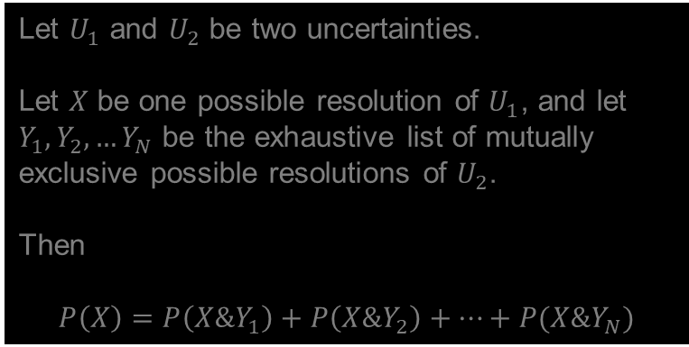
Marginal Uncertainty, Marginal Probability
In a war, how well will the military perform?
Joint Probability
Marginal Probability
poorly
moderately
excellently
Let $U_{1}$ and $U_{2}$ be two uncertainties.
Let $X$ be one possible resolution of $U_{1}$, and let $Y_{1}, Y_{2}, …Y_{N}$ be the exhaustive list of mutually exclusive possible resolutions of $U_{2}$.
Then
$$P\left(X\right)=P\left(X\&Y_{1}\right)+P\left(X\&Y_{2}\right)+⋯+P(X\&Y_{N})$$
succeed
$$P(\text{succeed}\text{ \& }\text{moderately})$$
$$P(\text{succeed})$$
$$P(\text{succeed}\text{ \& }\text{poorly})$$
$$P(\text{succeed}\text{ \& }\text{excellently})$$
If coup attempted, will it succeed?
$$P(\text{fail}\text{ \& }\text{poorly})$$
$$P(\text{fail}\text{ \& }\text{moderately})$$
$$P(\text{fail}\text{ \& }\text{excellently})$$
$$P(\text{fail})$$
fail
$$P(\text{poorly})$$
$$P(\text{moderately})$$
$$P(\text{excellently})$$

Slide 121
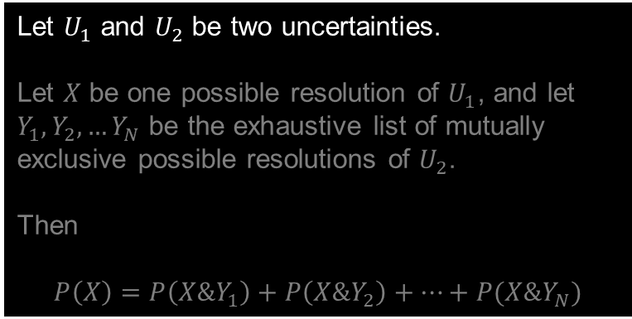
Marginal Uncertainty, Marginal Probability
In a war, how well will the military perform?
Joint Probability
Marginal Probability
poorly
moderately
excellently
Let $U_{1}$ and $U_{2}$ be two uncertainties.
Let $X$ be one possible resolution of $U_{1}$, and let $Y_{1}, Y_{2}, …Y_{N}$ be the exhaustive list of mutually exclusive possible resolutions of $U_{2}$.
Then
$$P\left(X\right)=P\left(X\&Y_{1}\right)+P\left(X\&Y_{2}\right)+⋯+P(X\&Y_{N})$$
succeed
$$P(\text{succeed}\text{ \& }\text{moderately})$$
$$P(\text{succeed})$$
$$P(\text{succeed}\text{ \& }\text{poorly})$$
$$P(\text{succeed}\text{ \& }\text{excellently})$$
If coup attempted, will it succeed?
$$P(\text{fail}\text{ \& }\text{poorly})$$
$$P(\text{fail}\text{ \& }\text{moderately})$$
$$P(\text{fail}\text{ \& }\text{excellently})$$
$$P(\text{fail})$$
fail
$$P(\text{poorly})$$
$$P(\text{moderately})$$
$$P(\text{excellently})$$

Slide 122


Marginal Uncertainty, Marginal Probability
EXAMPLE
$$U_{2}$$
In a war, how well will the military perform?
Joint Probability
Marginal Probability
poorly
moderately
excellently
Let $U_{1}$ and $U_{2}$ be two uncertainties.
Let $X$ be one possible resolution of $U_{1}$, and let $Y_{1}, Y_{2}, …Y_{N}$ be the exhaustive list of mutually exclusive possible resolutions of $U_{2}$.
Then
$$P\left(X\right)=P\left(X\&Y_{1}\right)+P\left(X\&Y_{2}\right)+⋯+P(X\&Y_{N})$$
$$U_{1}$$
succeed
$$P(\text{succeed}\text{ \& }\text{moderately})$$
$$P(\text{succeed})$$
$$P(\text{succeed}\text{ \& }\text{poorly})$$
$$P(\text{succeed}\text{ \& }\text{excellently})$$
If coup attempted, will it succeed?
$$P(\text{fail}\text{ \& }\text{poorly})$$
$$P(\text{fail}\text{ \& }\text{moderately})$$
$$P(\text{fail}\text{ \& }\text{excellently})$$
$$P(\text{fail})$$
fail
$$P(\text{poorly})$$
$$P(\text{moderately})$$
$$P(\text{excellently})$$

Slide 123
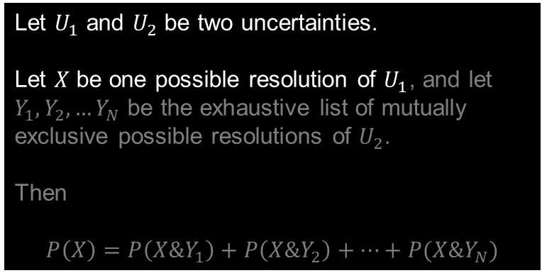

Marginal Uncertainty, Marginal Probability
$$U_{2}$$
EXAMPLE
In a war, how well will the military perform?
Joint Probability
Marginal Probability
poorly
moderately
excellently
Let $U_{1}$ and $U_{2}$ be two uncertainties.
Let $X$ be one possible resolution of $U_{1}$, and let $Y_{1}, Y_{2}, …Y_{N}$ be the exhaustive list of mutually exclusive possible resolutions of $U_{2}$.
Then
$$P\left(X\right)=P\left(X\&Y_{1}\right)+P\left(X\&Y_{2}\right)+⋯+P(X\&Y_{N})$$
$$U_{1}$$
succeed
$$P(\text{succeed}\text{ \& }\text{moderately})$$
$$P(\text{succeed})$$
$$P(\text{succeed}\text{ \& }\text{poorly})$$
$$P(\text{succeed}\text{ \& }\text{excellently})$$
If coup attempted, will it succeed?
$$P(\text{fail}\text{ \& }\text{poorly})$$
$$P(\text{fail}\text{ \& }\text{moderately})$$
$$P(\text{fail}\text{ \& }\text{excellently})$$
$$P(\text{fail})$$
fail
$$P(\text{poorly})$$
$$P(\text{moderately})$$
$$P(\text{excellently})$$

Slide 124

Marginal Uncertainty, Marginal Probability
$$U_{2}$$
EXAMPLE
In a war, how well will the military perform?
Joint Probability
Marginal Probability
poorly
moderately
excellently
Let $U_{1}$ and $U_{2}$ be two uncertainties.
Let $X$ be one possible resolution of $U_{1}$, and let $Y_{1}, Y_{2}, …Y_{N}$ be the exhaustive list of mutually exclusive possible resolutions of $U_{2}$.
Then
$$P\left(X\right)=P\left(X\&Y_{1}\right)+P\left(X\&Y_{2}\right)+⋯+P(X\&Y_{N})$$
$$U_{1}$$
succeed
$$P(\text{succeed}\text{ \& }\text{moderately})$$
$$P(\text{succeed})$$
$$P(\text{succeed}\text{ \& }\text{poorly})$$
$$P(\text{succeed}\text{ \& }\text{excellently})$$
$$X$$
If coup attempted, will it succeed?
$$P(\text{fail}\text{ \& }\text{poorly})$$
$$P(\text{fail}\text{ \& }\text{moderately})$$
$$P(\text{fail}\text{ \& }\text{excellently})$$
$$P(\text{fail})$$
fail
$$P(\text{poorly})$$
$$P(\text{moderately})$$
$$P(\text{excellently})$$

Slide 125
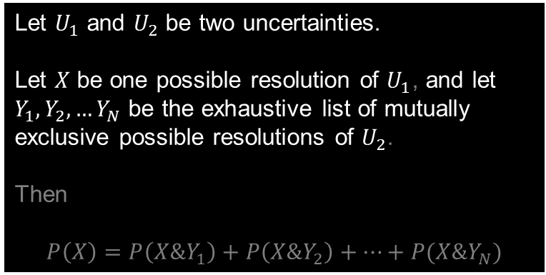

Marginal Uncertainty, Marginal Probability
$$U_{2}$$
EXAMPLE
In a war, how well will the military perform?
Joint Probability
Marginal Probability
poorly
moderately
excellently
Let $U_{1}$ and $U_{2}$ be two uncertainties.
Let $X$ be one possible resolution of $U_{1}$, and let $Y_{1}, Y_{2}, …Y_{N}$ be the exhaustive list of mutually exclusive possible resolutions of $U_{2}$.
Then
$$P\left(X\right)=P\left(X\&Y_{1}\right)+P\left(X\&Y_{2}\right)+⋯+P(X\&Y_{N})$$
$$U_{1}$$
succeed
$$P(\text{succeed}\text{ \& }\text{moderately})$$
$$P(\text{succeed})$$
$$P(\text{succeed}\text{ \& }\text{poorly})$$
$$P(\text{succeed}\text{ \& }\text{excellently})$$
$$X$$
If coup attempted, will it succeed?
$$P(\text{fail}\text{ \& }\text{poorly})$$
$$P(\text{fail}\text{ \& }\text{moderately})$$
$$P(\text{fail}\text{ \& }\text{excellently})$$
$$P(\text{fail})$$
fail
$$P(\text{poorly})$$
$$P(\text{moderately})$$
$$P(\text{excellently})$$

Slide 126
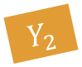


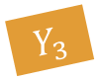
Marginal Uncertainty, Marginal Probability
$$U_{2}$$
EXAMPLE
In a war, how well will the military perform?
Joint Probability
Marginal Probability
$$Y_{1}$$
$$Y_{2}$$
$$Y_{3}$$
poorly
moderately
excellently
Let $U_{1}$ and $U_{2}$ be two uncertainties.
Let $X$ be one possible resolution of $U_{1}$, and let $Y_{1}, Y_{2}, …Y_{N}$ be the exhaustive list of mutually exclusive possible resolutions of $U_{2}$.
Then
$$P\left(X\right)=P\left(X\&Y_{1}\right)+P\left(X\&Y_{2}\right)+⋯+P(X\&Y_{N})$$
$$U_{1}$$
succeed
$$P(\text{succeed}\text{ \& }\text{moderately})$$
$$P(\text{succeed})$$
$$P(\text{succeed}\text{ \& }\text{poorly})$$
$$P(\text{succeed}\text{ \& }\text{excellently})$$
$$X$$
If coup attempted, will it succeed?
$$P(\text{fail}\text{ \& }\text{poorly})$$
$$P(\text{fail}\text{ \& }\text{moderately})$$
$$P(\text{fail}\text{ \& }\text{excellently})$$
$$P(\text{fail})$$
fail
$$P(\text{poorly})$$
$$P(\text{moderately})$$
$$P(\text{excellently})$$

Slide 127

Marginal Uncertainty, Marginal Probability
$$U_{2}$$
EXAMPLE
In a war, how well will the military perform?
Joint Probability
Marginal Probability
$$Y_{1}$$
$$Y_{2}$$
$$Y_{3}$$
poorly
moderately
excellently
Let $U_{1}$ and $U_{2}$ be two uncertainties.
Let $X$ be one possible resolution of $U_{1}$, and let $Y_{1}, Y_{2}, …Y_{N}$ be the exhaustive list of mutually exclusive possible resolutions of $U_{2}$.
Then
$$P\left(X\right)=P\left(X\&Y_{1}\right)+P\left(X\&Y_{2}\right)+⋯+P(X\&Y_{N})$$
$$U_{1}$$
succeed
$$P(\text{succeed}\text{ \& }\text{moderately})$$
$$P(\text{succeed})$$
$$P(\text{succeed}\text{ \& }\text{poorly})$$
$$P(\text{succeed}\text{ \& }\text{excellently})$$
$$X$$
If coup attempted, will it succeed?
$$P(\text{fail}\text{ \& }\text{poorly})$$
$$P(\text{fail}\text{ \& }\text{moderately})$$
$$P(\text{fail}\text{ \& }\text{excellently})$$
$$P(\text{fail})$$
fail
$$P(\text{poorly})$$
$$P(\text{moderately})$$
$$P(\text{excellently})$$

Slide 128
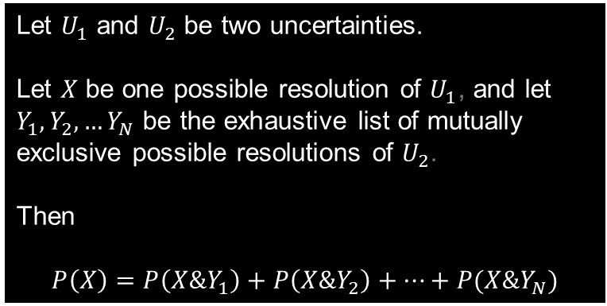
Marginal Uncertainty, Marginal Probability
$$U_{2}$$
EXAMPLE
In a war, how well will the military perform?
Joint Probability
Marginal Probability
$$Y_{1}$$
$$Y_{2}$$
$$Y_{3}$$
poorly
moderately
excellently
Let $U_{1}$ and $U_{2}$ be two uncertainties.
Let $X$ be one possible resolution of $U_{1}$, and let $Y_{1}, Y_{2}, …Y_{N}$ be the exhaustive list of mutually exclusive possible resolutions of $U_{2}$.
Then
$$P\left(X\right)=P\left(X\&Y_{1}\right)+P\left(X\&Y_{2}\right)+⋯+P(X\&Y_{N})$$
$$U_{1}$$
succeed
$$P(\text{succeed}\text{ \& }\text{moderately})$$
$$P(\text{succeed})$$
$$P(\text{succeed}\text{ \& }\text{poorly})$$
$$P(\text{succeed}\text{ \& }\text{excellently})$$
$$X$$
If coup attempted, will it succeed?
$$P(\text{fail}\text{ \& }\text{poorly})$$
$$P(\text{fail}\text{ \& }\text{moderately})$$
$$P(\text{fail}\text{ \& }\text{excellently})$$
$$P(\text{fail})$$
fail
$$P(\text{poorly})$$
$$P(\text{moderately})$$
$$P(\text{excellently})$$

Slide 129
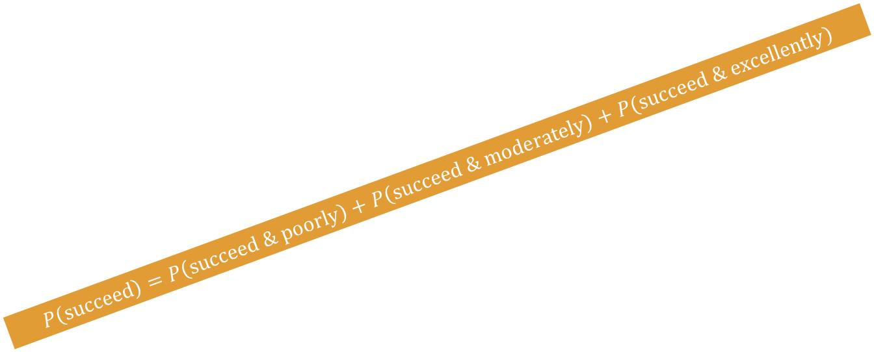
Marginal Uncertainty, Marginal Probability
$$U_{2}$$
EXAMPLE
In a war, how well will the military perform?
Joint Probability
Marginal Probability
$$Y_{1}$$
$$Y_{2}$$
$$Y_{3}$$
poorly
moderately
excellently
Let $U_{1}$ and $U_{2}$ be two uncertainties.
Let $X$ be one possible resolution of $U_{1}$, and let $Y_{1}, Y_{2}, …Y_{N}$ be the exhaustive list of mutually exclusive possible resolutions of $U_{2}$.
Then
$$P\left(X\right)=P\left(X\&Y_{1}\right)+P\left(X\&Y_{2}\right)+⋯+P(X\&Y_{N})$$
$$U_{1}$$
succeed
$$P(\text{succeed}\text{ \& }\text{moderately})$$
$$P(\text{succeed})$$
$$P(\text{succeed}\text{ \& }\text{poorly})$$
$$P(\text{succeed}\text{ \& }\text{excellently})$$
$$X$$
If coup attempted, will it succeed?
$$P(\text{fail}\text{ \& }\text{poorly})$$
$$P(\text{fail}\text{ \& }\text{moderately})$$
$$P(\text{fail}\text{ \& }\text{excellently})$$
$$P(\text{fail})$$
fail
$$P\left(\text{succeed}\right)=P\left(\text{succeed}\text{ \& }\text{poorly}\right)+P\left(\text{succeed}\text{ \& }\text{moderately}\right)+P(\text{succeed}\text{ \& }\text{excellently})$$
$$P(\text{poorly})$$
$$P(\text{moderately})$$
$$P(\text{excellently})$$

Slide 130






Marginal Uncertainty, Marginal Probability
EXAMPLE WITH SPECIFIC NUMERICAL VALUES
In a war, how well will the military perform?
Joint Probability
Marginal Probability
poorly
moderately
excellently
Let $U_{1}$ and $U_{2}$ be two uncertainties.
Let $X$ be one possible resolution of $U_{1}$, and let $Y_{1}, Y_{2}, …Y_{N}$ be the exhaustive list of mutually exclusive possible resolutions of $U_{2}$.
Then
$$P\left(X\right)=P\left(X\&Y_{1}\right)+P\left(X\&Y_{2}\right)+⋯+P(X\&Y_{N})$$
succeed
$$\frac{3}{37}$$
$$\frac{13}{37}$$
$$\frac{8}{37}$$
$$P(\text{succeed})$$
If coup attempted, will it succeed?
fail
$$\frac{10}{37}$$
$$\frac{1}{37}$$
$$\frac{2}{37}$$
$$P(\text{fail})$$
$$P(\text{poorly})$$
$$P(\text{moderately})$$
$$P(\text{excellently})$$

Slide 131

Marginal Uncertainty, Marginal Probability
EXAMPLE WITH SPECIFIC NUMERICAL VALUES
In a war, how well will the military perform?
Joint Probability
Marginal Probability
poorly
moderately
excellently
Let $U_{1}$ and $U_{2}$ be two uncertainties.
Let $X$ be one possible resolution of $U_{1}$, and let $Y_{1}, Y_{2}, …Y_{N}$ be the exhaustive list of mutually exclusive possible resolutions of $U_{2}$.
Then
$$P\left(X\right)=P\left(X\&Y_{1}\right)+P\left(X\&Y_{2}\right)+⋯+P(X\&Y_{N})$$
succeed
$$\frac{3}{37}$$
$$\frac{13}{37}$$
$$\frac{8}{37}$$
$$\frac{24}{37}$$
If coup attempted, will it succeed?
fail
$$\frac{10}{37}$$
$$\frac{1}{37}$$
$$\frac{2}{37}$$
$$P(\text{fail})$$
$$P(\text{poorly})$$
$$P(\text{moderately})$$
$$P(\text{excellently})$$

Slide 132


Marginal Uncertainty, Marginal Probability
EXAMPLE WITH SPECIFIC NUMERICAL VALUES
In a war, how well will the military perform?
Joint Probability
Marginal Probability
poorly
moderately
excellently
Let $U_{1}$ and $U_{2}$ be two uncertainties.
Let $X$ be one possible resolution of $U_{1}$, and let $Y_{1}, Y_{2}, …Y_{N}$ be the exhaustive list of mutually exclusive possible resolutions of $U_{2}$.
Then
$$P\left(X\right)=P\left(X\&Y_{1}\right)+P\left(X\&Y_{2}\right)+⋯+P(X\&Y_{N})$$
succeed
$$\frac{3}{37}$$
$$\frac{13}{37}$$
$$\frac{8}{37}$$
$$\frac{24}{37}$$
If coup attempted, will it succeed?
fail
$$\frac{10}{37}$$
$$\frac{1}{37}$$
$$\frac{2}{37}$$
$$\frac{13}{37}$$
$$P(\text{poorly})$$
$$P(\text{moderately})$$
$$P(\text{excellently})$$

Slide 133


Marginal Uncertainty, Marginal Probability
EXAMPLE WITH SPECIFIC NUMERICAL VALUES
In a war, how well will the military perform?
Joint Probability
Marginal Probability
poorly
moderately
excellently
Let $U_{1}$ and $U_{2}$ be two uncertainties.
Let $X$ be one possible resolution of $U_{1}$, and let $Y_{1}, Y_{2}, …Y_{N}$ be the exhaustive list of mutually exclusive possible resolutions of $U_{2}$.
Then
$$P\left(X\right)=P\left(X\&Y_{1}\right)+P\left(X\&Y_{2}\right)+⋯+P(X\&Y_{N})$$
succeed
$$\frac{3}{37}$$
$$\frac{13}{37}$$
$$\frac{8}{37}$$
$$\frac{24}{37}$$
If coup attempted, will it succeed?
fail
$$\frac{10}{37}$$
$$\frac{1}{37}$$
$$\frac{2}{37}$$
$$\frac{13}{37}$$
$$P(\text{poorly})$$
$$P(\text{moderately})$$
$$\frac{10}{37}$$

Slide 134


Marginal Uncertainty, Marginal Probability
EXAMPLE WITH SPECIFIC NUMERICAL VALUES
In a war, how well will the military perform?
Joint Probability
Marginal Probability
poorly
moderately
excellently
Let $U_{1}$ and $U_{2}$ be two uncertainties.
Let $X$ be one possible resolution of $U_{1}$, and let $Y_{1}, Y_{2}, …Y_{N}$ be the exhaustive list of mutually exclusive possible resolutions of $U_{2}$.
Then
$$P\left(X\right)=P\left(X\&Y_{1}\right)+P\left(X\&Y_{2}\right)+⋯+P(X\&Y_{N})$$
succeed
$$\frac{3}{37}$$
$$\frac{13}{37}$$
$$\frac{8}{37}$$
$$\frac{24}{37}$$
If coup attempted, will it succeed?
fail
$$\frac{10}{37}$$
$$\frac{1}{37}$$
$$\frac{2}{37}$$
$$\frac{13}{37}$$
$$P(\text{poorly})$$
$$\frac{14}{37}$$
$$\frac{10}{37}$$

Slide 135


Marginal Uncertainty, Marginal Probability
EXAMPLE WITH SPECIFIC NUMERICAL VALUES
In a war, how well will the military perform?
Joint Probability
Marginal Probability
poorly
moderately
excellently
Let $U_{1}$ and $U_{2}$ be two uncertainties.
Let $X$ be one possible resolution of $U_{1}$, and let $Y_{1}, Y_{2}, …Y_{N}$ be the exhaustive list of mutually exclusive possible resolutions of $U_{2}$.
Then
$$P\left(X\right)=P\left(X\&Y_{1}\right)+P\left(X\&Y_{2}\right)+⋯+P(X\&Y_{N})$$
succeed
$$\frac{3}{37}$$
$$\frac{13}{37}$$
$$\frac{8}{37}$$
$$\frac{24}{37}$$
If coup attempted, will it succeed?
fail
$$\frac{10}{37}$$
$$\frac{1}{37}$$
$$\frac{2}{37}$$
$$\frac{13}{37}$$
$$\frac{13}{37}$$
$$\frac{14}{37}$$
$$\frac{10}{37}$$

Slide 136
Terminology and Notation
Relationships
Joint Event You should now have something in your notes for this!
Joint Probability You should now have something in your notes for this!
Marginal Uncertainty You should now have something in your notes for this!
Marginal Probability You should now have something in your notes for this!
Conditional Uncertainty
Conditional Probability
Joint Probability
Marginal Probability
you should have something in your notes for this now!
Marginal Probability
Joint Probability
Conditional Probability

Slide 137
Motivation & Example – the Guardianship Dilemma
Joint Uncertainty, Joint Events, Joint Probability
Marginal Uncertainty, Marginal Probability
Conditional Uncertainty, Conditional Probability
The Marginal-Conditional Method of Modeling Joint Uncertainty
z

Slide 138
Conditional Uncertainty, Conditional Probability
In a war, how well will the military perform?
poorly
moderately
excellently
succeed
If coup attempted, will it succeed?
fail

Slide 139

Conditional Uncertainty, Conditional Probability

Slide 140

Conditional Uncertainty, Conditional Probability
If the military attempts a coup will it succeed?

Slide 141
Conditional Uncertainty, Conditional Probability
If the military attempts a coup will it succeed?
And if the military goes to war with a foreign adversary, how well will it perform?

Slide 142
Conditional Uncertainty, Conditional Probability
Welp...

Slide 143
Conditional Uncertainty, Conditional Probability
Welp...Just before I went to bed, I ordered the military to invade the country next door at 4am tomorrow morning...

Slide 144
Conditional Uncertainty, Conditional Probability
I, of course, will be sleeping until 11am.

Slide 145
Conditional Uncertainty, Conditional Probability
So, when I wake up...and after I have had a few shots of whiskey...I will meet with the Minister of Defense, and he will tell me how the invasion has gone.

Slide 146
Conditional Uncertainty, Conditional Probability
So as of about 12:30 tomorrow afternoon, I will KNOW how well my military will perform when it goes to war with an opposing military!

Slide 147
Conditional Uncertainty, Conditional Probability
...And perhaps that will give me a clue about whether a coup attempt by the military would succeed!

Slide 148
Conditional Uncertainty, Conditional Probability
President’s beliefs at bedtime the night before the invasion

Slide 149
Conditional Uncertainty, Conditional Probability
In a war, how well will the military perform?
President’s beliefs at bedtime the night before the invasion
poorly
moderately
excellently
succeed
If coup attempted, will it succeed?
fail
next morning, the defense minister says the military performed...

Slide 150
Conditional Uncertainty, Conditional Probability
In a war, how well will the military perform?
President’s beliefs at bedtime the night before the invasion
poorly
moderately
excellently
succeed
If coup attempted, will it succeed?
fail
next morning, the defense minister says the military performed...
poorly
moderately
excellently

Slide 151
Conditional Uncertainty, Conditional Probability
In a war, how well will the military perform?
President’s beliefs at bedtime the night before the invasion
poorly
moderately
excellently
succeed
If coup attempted, will it succeed?
fail
next morning, the defense minister says the military performed...
poorly
moderately
excellently
President’s beliefs after the minister’s report

Slide 152
Conditional Uncertainty, Conditional Probability
In a war, how well will the military perform?
President’s beliefs at bedtime the night before the invasion
poorly
moderately
excellently
succeed
If coup attempted, will it succeed?
fail
next morning, the defense minister says the military performed...
poorly
moderately
excellently
In a war, how well will the military perform?
poorly
moderately
excellently
President’s beliefs after the minister’s report
succeed
If coup attempted, will it succeed?
fail

Slide 153
Conditional Uncertainty, Conditional Probability
In a war, how well will the military perform?
President’s beliefs at bedtime the night before the invasion
poorly
moderately
excellently
succeed
If coup attempted, will it succeed?
fail
next morning, the defense minister says the military performed...
poorly
moderately
excellently
In a war, how well will the military perform?
In a war, how well will the military perform?
In a war, how well will the military perform?
poorly
moderately
excellently
poorly
moderately
excellently
poorly
moderately
excellently
President’s beliefs after the minister’s report
succeed
succeed
succeed
If coup attempted, will it succeed?
If coup attempted, will it succeed?
If coup attempted, will it succeed?
fail
fail
fail

Slide 154
Conditional Uncertainty, Conditional Probability
In a war, how well will the military perform?
President’s beliefs at bedtime the night before the invasion
poorly
moderately
excellently
succeed
If coup attempted, will it succeed?
fail
next morning, the defense minister says the military performed...
poorly
moderately
excellently
In a war, how well will the military perform?
In a war, how well will the military perform?
In a war, how well will the military perform?
poorly
moderately
excellently
poorly
moderately
excellently
poorly
moderately
excellently
President’s beliefs after the minister’s report
succeed
succeed
succeed
If coup attempted, will it succeed?
If coup attempted, will it succeed?
If coup attempted, will it succeed?
fail
fail
fail

Slide 155
Conditional Uncertainty, Conditional Probability
TERMINOLOGY AND NOTATION: Conditional Uncertainty, Conditional Probability
In a war, how well will the military perform?
President’s beliefs at bedtime the night before the invasion
poorly
moderately
excellently
succeed
If coup attempted, will it succeed?
fail
next morning, the defense minister says the military performed...
poorly
moderately
excellently
In a war, how well will the military perform?
In a war, how well will the military perform?
In a war, how well will the military perform?
poorly
moderately
excellently
poorly
moderately
excellently
poorly
moderately
excellently
President’s beliefs after the minister’s report
succeed
succeed
succeed
If coup attempted, will it succeed?
If coup attempted, will it succeed?
If coup attempted, will it succeed?
fail
fail
fail

Slide 156

Conditional Uncertainty, Conditional Probability
TERMINOLOGY AND NOTATION: Conditional Uncertainty, Conditional Probability
In a war, how well will the military perform?
President’s beliefs at bedtime the night before the invasion
poorly
moderately
excellently
succeed
Conditional uncertainty is uncertainty about one issue, given knowledge of how some other uncertain issue was, is, or will be resolved.
Let $X$ be one possible resolution of one uncertainty $U_{1}$, and let $Y$ be one possible resolution of some other uncertainty $U_{2}$. Then the probability that $X$ is the resolution of $U_{1}$ conditional on the knowledge that $Y$ was, is, or will be the resolution of $U_{2}$ is written as $P(X|Y)$.
If coup attempted, will it succeed?
fail
next morning, the defense minister says the military performed...
poorly
moderately
excellently
In a war, how well will the military perform?
In a war, how well will the military perform?
In a war, how well will the military perform?
poorly
moderately
excellently
poorly
moderately
excellently
poorly
moderately
excellently
President’s beliefs after the minister’s report
succeed
succeed
succeed
If coup attempted, will it succeed?
If coup attempted, will it succeed?
If coup attempted, will it succeed?
fail
fail
fail

Slide 157
Conditional Uncertainty, Conditional Probability
TERMINOLOGY AND NOTATION: Conditional Uncertainty, Conditional Probability
In a war, how well will the military perform?
President’s beliefs at bedtime the night before the invasion
poorly
moderately
excellently
succeed
Conditional uncertainty is uncertainty about one issue, given knowledge of how some other uncertain issue was, is, or will be resolved.
Let $X$ be one possible resolution of one uncertainty $U_{1}$, and let $Y$ be one possible resolution of some other uncertainty $U_{2}$. Then the probability that $X$ is the resolution of $U_{1}$ conditional on the knowledge that $Y$ was, is, or will be the resolution of $U_{2}$ is written as $P(X|Y)$.
If coup attempted, will it succeed?
fail
next morning, the defense minister says the military performed...
EXAMPLE: Uncertainty about whether a coup attempt would succeed, given knowledge that the military performs poorly in a war against a foreign military.
poorly
moderately
excellently
In a war, how well will the military perform?
In a war, how well will the military perform?
In a war, how well will the military perform?
poorly
moderately
excellently
poorly
moderately
excellently
poorly
moderately
excellently
President’s beliefs after the minister’s report
succeed
succeed
succeed
If coup attempted, will it succeed?
If coup attempted, will it succeed?
If coup attempted, will it succeed?
fail
fail
fail

Slide 158

Conditional Uncertainty, Conditional Probability
TERMINOLOGY AND NOTATION: Conditional Uncertainty, Conditional Probability
In a war, how well will the military perform?
President’s beliefs at bedtime the night before the invasion
poorly
moderately
excellently
succeed
Conditional uncertainty is uncertainty about one issue, given knowledge of how some other uncertain issue was, is, or will be resolved.
Let $X$ be one possible resolution of one uncertainty $U_{1}$, and let $Y$ be one possible resolution of some other uncertainty $U_{2}$. Then the probability that $X$ is the resolution of $U_{1}$ conditional on the knowledge that $Y$ was, is, or will be the resolution of $U_{2}$ is written as $P(X|Y)$.
If coup attempted, will it succeed?
fail
next morning, the defense minister says the military performed...
poorly
moderately
excellently
In a war, how well will the military perform?
In a war, how well will the military perform?
In a war, how well will the military perform?
poorly
moderately
excellently
poorly
moderately
excellently
poorly
moderately
excellently
President’s beliefs after the minister’s report
succeed
succeed
succeed
If coup attempted, will it succeed?
If coup attempted, will it succeed?
If coup attempted, will it succeed?
fail
fail
fail

Slide 159
Conditional Uncertainty, Conditional Probability
TERMINOLOGY AND NOTATION: Conditional Uncertainty, Conditional Probability
In a war, how well will the military perform?
President’s beliefs at bedtime the night before the invasion
poorly
moderately
excellently
succeed
Conditional uncertainty is uncertainty about one issue, given knowledge of how some other uncertain issue was, is, or will be resolved.
Let $X$ be one possible resolution of one uncertainty $U_{1}$, and let $Y$ be one possible resolution of some other uncertainty $U_{2}$. Then the probability that $X$ is the resolution of $U_{1}$ conditional on the knowledge that $Y$ was, is, or will be the resolution of $U_{2}$ is written as $P(X|Y)$.
If coup attempted, will it succeed?
fail
next morning, the defense minister says the military performed...
EXAMPLE: “succeed” is one possible resolution of the uncertainty about whether an attempted coup will succeed.
poorly
moderately
excellently
In a war, how well will the military perform?
In a war, how well will the military perform?
In a war, how well will the military perform?
poorly
moderately
excellently
poorly
moderately
excellently
poorly
moderately
excellently
President’s beliefs after the minister’s report
succeed
succeed
succeed
If coup attempted, will it succeed?
If coup attempted, will it succeed?
If coup attempted, will it succeed?
fail
fail
fail

Slide 160

Conditional Uncertainty, Conditional Probability
TERMINOLOGY AND NOTATION: Conditional Uncertainty, Conditional Probability
In a war, how well will the military perform?
President’s beliefs at bedtime the night before the invasion
poorly
moderately
excellently
succeed
Conditional uncertainty is uncertainty about one issue, given knowledge of how some other uncertain issue was, is, or will be resolved.
Let $X$ be one possible resolution of one uncertainty $U_{1}$, and let $Y$ be one possible resolution of some other uncertainty $U_{2}$. Then the probability that $X$ is the resolution of $U_{1}$ conditional on the knowledge that $Y$ was, is, or will be the resolution of $U_{2}$ is written as $P(X|Y)$.
If coup attempted, will it succeed?
fail
next morning, the defense minister says the military performed...
poorly
moderately
excellently
In a war, how well will the military perform?
In a war, how well will the military perform?
In a war, how well will the military perform?
poorly
moderately
excellently
poorly
moderately
excellently
poorly
moderately
excellently
President’s beliefs after the minister’s report
succeed
succeed
succeed
If coup attempted, will it succeed?
If coup attempted, will it succeed?
If coup attempted, will it succeed?
fail
fail
fail

Slide 161
Conditional Uncertainty, Conditional Probability
TERMINOLOGY AND NOTATION: Conditional Uncertainty, Conditional Probability
In a war, how well will the military perform?
President’s beliefs at bedtime the night before the invasion
poorly
moderately
excellently
succeed
Conditional uncertainty is uncertainty about one issue, given knowledge of how some other uncertain issue was, is, or will be resolved.
Let $X$ be one possible resolution of one uncertainty $U_{1}$, and let $Y$ be one possible resolution of some other uncertainty $U_{2}$. Then the probability that $X$ is the resolution of $U_{1}$ conditional on the knowledge that $Y$ was, is, or will be the resolution of $U_{2}$ is written as $P(X|Y)$.
If coup attempted, will it succeed?
fail
next morning, the defense minister says the military performed...
EXAMPLE: “excellently” is one possible resolution of the uncertainty about how well the military will perform against a foreign military.
poorly
moderately
excellently
In a war, how well will the military perform?
In a war, how well will the military perform?
In a war, how well will the military perform?
poorly
moderately
excellently
poorly
moderately
excellently
poorly
moderately
excellently
President’s beliefs after the minister’s report
succeed
succeed
succeed
If coup attempted, will it succeed?
If coup attempted, will it succeed?
If coup attempted, will it succeed?
fail
fail
fail

Slide 162

Conditional Uncertainty, Conditional Probability
TERMINOLOGY AND NOTATION: Conditional Uncertainty, Conditional Probability
In a war, how well will the military perform?
President’s beliefs at bedtime the night before the invasion
poorly
moderately
excellently
succeed
Conditional uncertainty is uncertainty about one issue, given knowledge of how some other uncertain issue was, is, or will be resolved.
Let $X$ be one possible resolution of one uncertainty $U_{1}$, and let $Y$ be one possible resolution of some other uncertainty $U_{2}$. Then the probability that $X$ is the resolution of $U_{1}$ conditional on the knowledge that $Y$ was, is, or will be the resolution of $U_{2}$ is written as $P(X|Y)$.
If coup attempted, will it succeed?
fail
next morning, the defense minister says the military performed...
poorly
moderately
excellently
In a war, how well will the military perform?
In a war, how well will the military perform?
In a war, how well will the military perform?
poorly
moderately
excellently
poorly
moderately
excellently
poorly
moderately
excellently
President’s beliefs after the minister’s report
succeed
succeed
succeed
If coup attempted, will it succeed?
If coup attempted, will it succeed?
If coup attempted, will it succeed?
fail
fail
fail

Slide 163

Conditional Uncertainty, Conditional Probability
TERMINOLOGY AND NOTATION: Conditional Uncertainty, Conditional Probability
In a war, how well will the military perform?
President’s beliefs at bedtime the night before the invasion
poorly
moderately
excellently
succeed
Conditional uncertainty is uncertainty about one issue, given knowledge of how some other uncertain issue was, is, or will be resolved.
Let $X$ be one possible resolution of one uncertainty $U_{1}$, and let $Y$ be one possible resolution of some other uncertainty $U_{2}$. Then the probability that $X$ is the resolution of $U_{1}$ conditional on the knowledge that $Y$ was, is, or will be the resolution of $U_{2}$ is written as $P(X|Y)$.
If coup attempted, will it succeed?
fail
next morning, the defense minister says the military performed...
EXAMPLE:
$$P(\text{succeed}|\text{excellently})$$
poorly
moderately
excellently
In a war, how well will the military perform?
In a war, how well will the military perform?
In a war, how well will the military perform?
poorly
moderately
excellently
poorly
moderately
excellently
poorly
moderately
excellently
President’s beliefs after the minister’s report
succeed
succeed
succeed
If coup attempted, will it succeed?
If coup attempted, will it succeed?
If coup attempted, will it succeed?
fail
fail
fail

Slide 164
Terminology and Notation
Relationships
Joint Event You should now have something in your notes for this!
Joint Probability You should now have something in your notes for this!
Marginal Uncertainty You should now have something in your notes for this!
Marginal Probability You should now have something in your notes for this!
Conditional Uncertainty You should now have something in your notes for this!
Conditional Probability You should now have something in your notes for this!
Joint Probability
Marginal Probability
you should have something in your notes for this now!
Marginal Probability
Joint Probability
Conditional Probability

Slide 165






Conditional Uncertainty, Conditional Probability
Modeling Conditional Uncertainty
In a war, how well will the military perform?
In a war, how well will the military perform?
In a war, how well will the military perform?
poorly
moderately
excellently
poorly
moderately
excellently
poorly
moderately
excellently
succeed
$$p(\text{succeed}|\text{poorly})$$
succeed
$$p(\text{succeed}|\text{moderately})$$
succeed
$$p(\text{succeed}|\text{excellently})$$
If coup attempted, will it succeed?
If coup attempted, will it succeed?
If coup attempted, will it succeed?
fail
fail
fail
$$p(\text{fail}|\text{poorly})$$
$$p(\text{fail}|\text{moderately})$$
$$p(\text{fail}|\text{excellently})$$

Slide 166
Conditional Uncertainty, Conditional Probability
Modeling Conditional Uncertainty
In a war, how well will the military perform?
In a war, how well will the military perform?
In a war, how well will the military perform?
poorly
moderately
excellently
poorly
moderately
excellently
poorly
moderately
excellently
succeed
$$p(\text{succeed}|\text{poorly})$$
succeed
$$p(\text{succeed}|\text{moderately})$$
succeed
$$p(\text{succeed}|\text{excellently})$$
If coup attempted, will it succeed?
If coup attempted, will it succeed?
If coup attempted, will it succeed?
fail
fail
fail
$$p(\text{fail}|\text{poorly})$$
$$p(\text{fail}|\text{moderately})$$
$$p(\text{fail}|\text{excellently})$$
TRUE OR FALSE?
Conditional on knowledge of how well the military will perform in a combat with a foreign military,
“a coup attempt would succeed”
“a coup attempt would fail”
amounts to the exhaustive list of mutually exclusive possible resolutions of his remaining uncertainty.

Slide 167
Conditional Uncertainty, Conditional Probability
Modeling Conditional Uncertainty
In a war, how well will the military perform?
In a war, how well will the military perform?
In a war, how well will the military perform?
poorly
moderately
excellently
poorly
moderately
excellently
poorly
moderately
excellently
succeed
$$p(\text{succeed}|\text{poorly})$$
succeed
$$p(\text{succeed}|\text{moderately})$$
succeed
$$p(\text{succeed}|\text{excellently})$$
If coup attempted, will it succeed?
If coup attempted, will it succeed?
If coup attempted, will it succeed?
fail
fail
fail
$$p(\text{fail}|\text{poorly})$$
$$p(\text{fail}|\text{moderately})$$
$$p(\text{fail}|\text{excellently})$$
TRUE OR FALSE?
TRUE!!!!!
Conditional on knowledge of how well the military will perform in a combat with a foreign military,
“a coup attempt would succeed”
“a coup attempt would fail”
amounts to the exhaustive list of mutually exclusive possible resolutions of his remaining uncertainty.

Slide 168

Conditional Uncertainty, Conditional Probability
Modeling Conditional Uncertainty
In a war, how well will the military perform?
In a war, how well will the military perform?
In a war, how well will the military perform?
poorly
moderately
excellently
poorly
moderately
excellently
poorly
moderately
excellently
succeed
$$p(\text{succeed}|\text{poorly})$$
succeed
$$p(\text{succeed}|\text{moderately})$$
succeed
$$p(\text{succeed}|\text{excellently})$$
If coup attempted, will it succeed?
If coup attempted, will it succeed?
If coup attempted, will it succeed?
fail
fail
fail
$$p(\text{fail}|\text{poorly})$$
$$p(\text{fail}|\text{moderately})$$
$$p(\text{fail}|\text{excellently})$$
THEREFORE:
TRUE OR FALSE?
TRUE!!!!!
$$P\left(\text{succeed} | \text{poorly}\right)+P\left(\text{fail} | \text{poorly}\right)=1$$
and
$$P\left(\text{succeed} | \text{moderately}\right)+P\left(\text{fail} | \text{moderately}\right)=1$$
and
$$P\left(\text{succeed} | \text{excellently}\right)+P\left(\text{fail} | \text{excellently}\right)=1$$
Conditional on knowledge of how well the military will perform in a combat with a foreign military,
“a coup attempt would succeed”
“a coup attempt would fail”
amounts to the exhaustive list of mutually exclusive possible resolutions of his remaining uncertainty.

Slide 169
Conditional Uncertainty, Conditional Probability
Modeling Conditional Uncertainty
In a war, how well will the military perform?
In a war, how well will the military perform?
In a war, how well will the military perform?
poorly
moderately
excellently
poorly
moderately
excellently
poorly
moderately
excellently
These sum to 1
These sum to 1
These sum to 1
succeed
$$p(\text{succeed}|\text{poorly})$$
succeed
$$p(\text{succeed}|\text{moderately})$$
succeed
$$p(\text{succeed}|\text{excellently})$$
If coup attempted, will it succeed?
If coup attempted, will it succeed?
If coup attempted, will it succeed?
fail
fail
fail
$$p(\text{fail}|\text{poorly})$$
$$p(\text{fail}|\text{moderately})$$
$$p(\text{fail}|\text{excellently})$$
THEREFORE:
TRUE OR FALSE?
TRUE!!!!!
$$P\left(\text{succeed} | \text{poorly}\right)+P\left(\text{fail} | \text{poorly}\right)=1$$
and
$$P\left(\text{succeed} | \text{moderately}\right)+P\left(\text{fail} | \text{moderately}\right)=1$$
and
$$P\left(\text{succeed} | \text{excellently}\right)+P\left(\text{fail} | \text{excellently}\right)=1$$
Conditional on knowledge of how well the military will perform in a combat with a foreign military,
“a coup attempt would succeed”
“a coup attempt would fail”
amounts to the exhaustive list of mutually exclusive possible resolutions of his remaining uncertainty.

Slide 170
Conditional Uncertainty, Conditional Probability
Modeling Conditional Uncertainty
In a war, how well will the military perform?
In a war, how well will the military perform?
In a war, how well will the military perform?
poorly
moderately
excellently
poorly
moderately
excellently
poorly
moderately
excellently
succeed
$$p(\text{succeed}|\text{poorly})$$
succeed
$$p(\text{succeed}|\text{moderately})$$
succeed
$$p(\text{succeed}|\text{excellently})$$
If coup attempted, will it succeed?
If coup attempted, will it succeed?
If coup attempted, will it succeed?
fail
fail
fail
$$p(\text{fail}|\text{poorly})$$
$$p(\text{fail}|\text{moderately})$$
$$p(\text{fail}|\text{excellently})$$

Slide 171
Conditional Uncertainty, Conditional Probability
Modeling Conditional Uncertainty
In a war, how well will the military perform?
In a war, how well will the military perform?
In a war, how well will the military perform?
poorly
moderately
excellently
poorly
moderately
excellently
poorly
moderately
excellently
succeed
$$p(\text{succeed}|\text{poorly})$$
succeed
$$p(\text{succeed}|\text{moderately})$$
succeed
$$p(\text{succeed}|\text{excellently})$$
If coup attempted, will it succeed?
If coup attempted, will it succeed?
If coup attempted, will it succeed?
fail
fail
fail
$$p(\text{fail}|\text{poorly})$$
$$p(\text{fail}|\text{moderately})$$
$$p(\text{fail}|\text{excellently})$$
...Hm...the military’s performance against the foreign military will tell me something about the likelihood that it would succeed in a coup!

Slide 172
Conditional Uncertainty, Conditional Probability
Modeling Conditional Uncertainty
In a war, how well will the military perform?
In a war, how well will the military perform?
In a war, how well will the military perform?
poorly
moderately
excellently
poorly
moderately
excellently
poorly
moderately
excellently
succeed
$$p(\text{succeed}|\text{poorly})$$
succeed
$$p(\text{succeed}|\text{moderately})$$
succeed
$$p(\text{succeed}|\text{excellently})$$
If coup attempted, will it succeed?
If coup attempted, will it succeed?
If coup attempted, will it succeed?
fail
fail
fail
$$p(\text{fail}|\text{poorly})$$
$$p(\text{fail}|\text{moderately})$$
$$p(\text{fail}|\text{excellently})$$
...If it performs poorly against foreign militaries, then it is less likely to be able to successfully pull off a coup than if it performs moderately or excellently against a foreign militaries!

Slide 173
Conditional Uncertainty, Conditional Probability
Modeling Conditional Uncertainty
In a war, how well will the military perform?
In a war, how well will the military perform?
In a war, how well will the military perform?
poorly
moderately
excellently
poorly
moderately
excellently
poorly
moderately
excellently
succeed
$$p(\text{succeed}|\text{poorly})$$
succeed
$$p(\text{succeed}|\text{moderately})$$
succeed
$$p(\text{succeed}|\text{excellently})$$
If coup attempted, will it succeed?
If coup attempted, will it succeed?
If coup attempted, will it succeed?
fail
fail
fail
$$p(\text{fail}|\text{poorly})$$
$$p(\text{fail}|\text{moderately})$$
$$p(\text{fail}|\text{excellently})$$
...If it performs poorly against foreign militaries, then it is less likely to be able to successfully pull off a coup than if it performs moderately or excellently against a foreign militaries!
MODEL THIS?

Slide 174
Conditional Uncertainty, Conditional Probability
Modeling Conditional Uncertainty
In a war, how well will the military perform?
In a war, how well will the military perform?
In a war, how well will the military perform?
poorly
moderately
excellently
poorly
moderately
excellently
poorly
moderately
excellently
succeed
$$p(\text{succeed}|\text{poorly})$$
succeed
$$p(\text{succeed}|\text{moderately})$$
succeed
$$p(\text{succeed}|\text{excellently})$$
If coup attempted, will it succeed?
If coup attempted, will it succeed?
If coup attempted, will it succeed?
fail
fail
fail
$$p(\text{fail}|\text{poorly})$$
$$p(\text{fail}|\text{moderately})$$
$$p(\text{fail}|\text{excellently})$$
MODEL THIS?

Slide 175

Conditional Uncertainty, Conditional Probability
Modeling Conditional Uncertainty
In a war, how well will the military perform?
In a war, how well will the military perform?
In a war, how well will the military perform?
poorly
moderately
excellently
poorly
moderately
excellently
poorly
moderately
excellently
succeed
$$p(\text{succeed}|\text{poorly})$$
succeed
$$p(\text{succeed}|\text{moderately})$$
succeed
$$p(\text{succeed}|\text{excellently})$$
If coup attempted, will it succeed?
If coup attempted, will it succeed?
If coup attempted, will it succeed?
fail
fail
fail
$$p(\text{fail}|\text{poorly})$$
$$p(\text{fail}|\text{moderately})$$
$$p(\text{fail}|\text{excellently})$$
MODEL THIS?
The President believes that
$$P\left(\text{succeed} | \text{poorly}\right)<P\left(\text{succeed} | \text{moderately}\right)<P(\text{succeed}\text{|}\text{excellently})$$

Slide 176




Conditional Uncertainty, Conditional Probability
Modeling Conditional Uncertainty
In a war, how well will the military perform?
In a war, how well will the military perform?
In a war, how well will the military perform?
poorly
moderately
excellently
poorly
moderately
excellently
poorly
moderately
excellently
succeed
$$\frac{1}{10}$$
succeed
$$\frac{2}{10}$$
succeed
$$\frac{3}{10}$$
If coup attempted, will it succeed?
If coup attempted, will it succeed?
If coup attempted, will it succeed?
fail
fail
fail
$$p(\text{fail}|\text{poorly})$$
$$p(\text{fail}|\text{moderately})$$
$$p(\text{fail}|\text{excellently})$$
MODEL THIS?
The President believes that
$$P\left(\text{succeed} | \text{poorly}\right)<P\left(\text{succeed} | \text{moderately}\right)<P(\text{succeed}\text{|}\text{excellently})$$
So how about...

Slide 177

Conditional Uncertainty, Conditional Probability
Modeling Conditional Uncertainty
In a war, how well will the military perform?
In a war, how well will the military perform?
In a war, how well will the military perform?
poorly
moderately
excellently
poorly
moderately
excellently
poorly
moderately
excellently
succeed
$$\frac{1}{10}$$
succeed
$$\frac{2}{10}$$
succeed
$$\frac{3}{10}$$
If coup attempted, will it succeed?
If coup attempted, will it succeed?
If coup attempted, will it succeed?
fail
fail
fail
$$p(\text{fail}|\text{poorly})$$
$$p(\text{fail}|\text{moderately})$$
$$p(\text{fail}|\text{excellently})$$
MODEL THIS?
The President believes that
$$P\left(\text{succeed} | \text{poorly}\right)<P\left(\text{succeed} | \text{moderately}\right)<P(\text{succeed}\text{|}\text{excellently})$$
So how about... and we know that (for instance) $P\left(\text{succeed} | \text{poorly}\right)+P\left(\text{fail} | \text{poorly}\right)=1$

Slide 178




Conditional Uncertainty, Conditional Probability
Modeling Conditional Uncertainty
In a war, how well will the military perform?
In a war, how well will the military perform?
In a war, how well will the military perform?
poorly
moderately
excellently
poorly
moderately
excellently
poorly
moderately
excellently
succeed
$$\frac{1}{10}$$
succeed
$$\frac{2}{10}$$
succeed
$$\frac{3}{10}$$
If coup attempted, will it succeed?
If coup attempted, will it succeed?
If coup attempted, will it succeed?
fail
$$\frac{9}{10}$$
fail
$$\frac{8}{10}$$
fail
$$\frac{7}{10}$$
MODEL THIS?
The President believes that
$$P\left(\text{succeed} | \text{poorly}\right)<P\left(\text{succeed} | \text{moderately}\right)<P(\text{succeed}\text{|}\text{excellently})$$
So how about... and we know that (for instance) $P\left(\text{succeed} | \text{poorly}\right)+P\left(\text{fail} | \text{poorly}\right)=1$
So...

Slide 179
Conditional Uncertainty, Conditional Probability
Modeling Conditional Uncertainty
TRY IT

Slide 180

Conditional Uncertainty, Conditional Probability
Modeling Conditional Uncertainty
TRY IT

Slide 181
Conditional Uncertainty, Conditional Probability
Modeling Conditional Uncertainty
TRY IT
I just got a tip from an informant that definitely resolves whether the military would succeed if it attempted a coup.

Slide 182
Conditional Uncertainty, Conditional Probability
Modeling Conditional Uncertainty
TRY IT
The details are too sensitive to share over the phone.

Slide 183
Conditional Uncertainty, Conditional Probability
Modeling Conditional Uncertainty
TRY IT
I’m in the basement of the internal security bureau with a full day of torturings tomorrow, but I can squeeze you in about 10:15 between a waterboarding and a mock execution. Meet me then, and I’ll give you all the facts.

Slide 184
Conditional Uncertainty, Conditional Probability
In a war, how well will the military perform?
President’s beliefs before meeting the internal security chief
Modeling Conditional Uncertainty
TRY IT
poorly
moderately
excellently
succeed
If coup attempted, will it succeed?
fail

Slide 185
Conditional Uncertainty, Conditional Probability
In a war, how well will the military perform?
President’s beliefs before meeting the internal security chief
Modeling Conditional Uncertainty
TRY IT
poorly
moderately
excellently
succeed
If coup attempted, will it succeed?
fail
in between torturings tomorrow, the chief will say one of two things

Slide 186
Conditional Uncertainty, Conditional Probability
In a war, how well will the military perform?
President’s beliefs before meeting the internal security chief
Modeling Conditional Uncertainty
TRY IT
poorly
moderately
excellently
succeed
If coup attempted, will it succeed?
fail
in between torturings tomorrow, the chief will say one of two things
A coup attempt would be successful
A coup attempt would fail

Slide 187
Conditional Uncertainty, Conditional Probability
In a war, how well will the military perform?
President’s beliefs before meeting the internal security chief
Modeling Conditional Uncertainty
TRY IT
poorly
moderately
excellently
succeed
If coup attempted, will it succeed?
fail
in between torturings tomorrow, the chief will say one of two things
A coup attempt would be successful
A coup attempt would fail
In a war, how well will the military perform?
In a war, how well will the military perform?
poorly
moderately
excellently
poorly
moderately
excellently
President’s beliefs after the meeting
succeed
succeed
If coup attempted, will it succeed?
If coup attempted, will it succeed?
fail
fail

Slide 188
Conditional Uncertainty, Conditional Probability
In a war, how well will the military perform?
President’s beliefs before meeting the internal security chief
Modeling Conditional Uncertainty
TRY IT
poorly
moderately
excellently
succeed
If coup attempted, will it succeed?
fail
in between torturings tomorrow, the chief will say one of two things
A coup attempt would be successful
A coup attempt would fail
In a war, how well will the military perform?
In a war, how well will the military perform?
poorly
moderately
excellently
poorly
moderately
excellently
President’s beliefs after the meeting
succeed
succeed
If coup attempted, will it succeed?
If coup attempted, will it succeed?
fail
fail

Slide 189
Conditional Uncertainty, Conditional Probability
In a war, how well will the military perform?
President’s beliefs before meeting the internal security chief
Modeling Conditional Uncertainty
TRY IT
poorly
moderately
excellently
Modeling Conditional Uncertainty
TRY IT
succeed
If coup attempted, will it succeed?
fail
in between torturings tomorrow, the chief will say one of two things
A coup attempt would be successful
A coup attempt would fail
In a war, how well will the military perform?
In a war, how well will the military perform?
poorly
moderately
excellently
poorly
moderately
excellently
President’s beliefs after the meeting
succeed
succeed
If coup attempted, will it succeed?
If coup attempted, will it succeed?
fail
fail

Slide 190
Conditional Uncertainty, Conditional Probability
In a war, how well will the military perform?
President’s beliefs before meeting the internal security chief
Modeling Conditional Uncertainty
TRY IT
poorly
moderately
excellently
Modeling Conditional Uncertainty
TRY IT
succeed
Assign specific numerical values for the probabilities in these two models of conditional uncertainty. Choose values that depict the idea that a military that would be successful in an attempted coup would be more likely to perform better in conflicts against foreign militaries than would a military that would be unsuccessful in an attempted coup.
If coup attempted, will it succeed?
fail
in between torturings tomorrow, the chief will say one of two things
A coup attempt would be successful
A coup attempt would fail
In a war, how well will the military perform?
In a war, how well will the military perform?
poorly
moderately
excellently
poorly
moderately
excellently
President’s beliefs after the meeting
succeed
succeed
If coup attempted, will it succeed?
If coup attempted, will it succeed?
fail
fail

Slide 191

Conditional Uncertainty, Conditional Probability
In a war, how well will the military perform?
President’s beliefs before meeting the internal security chief
Modeling Conditional Uncertainty
TRY IT
poorly
moderately
excellently
Modeling Conditional Uncertainty
TRY IT
succeed
Assign specific numerical values for the probabilities in these two models of conditional uncertainty. Choose values that depict the idea that a military that would be successful in an attempted coup would be more likely to perform better in conflicts against foreign militaries than would a military that would be unsuccessful in an attempted coup.
If coup attempted, will it succeed?
fail
in between torturings tomorrow, the chief will say one of two things
Basically, we want something like this:
$$P\left(\text{poorly} | \text{succeed}\right)<P(\text{poorly}|\text{fail})$$
and
$$P\left(\text{excellently} | \text{succeed}\right)>P(\text{excellently}|\text{fail})$$
A coup attempt would be successful
A coup attempt would fail
In a war, how well will the military perform?
In a war, how well will the military perform?
poorly
moderately
excellently
poorly
moderately
excellently
President’s beliefs after the meeting
succeed
succeed
If coup attempted, will it succeed?
If coup attempted, will it succeed?
fail
fail

Slide 192


Conditional Uncertainty, Conditional Probability
In a war, how well will the military perform?
President’s beliefs before meeting the internal security chief
Modeling Conditional Uncertainty
TRY IT
poorly
moderately
excellently
Modeling Conditional Uncertainty
TRY IT
succeed
Assign specific numerical values for the probabilities in these two models of conditional uncertainty. Choose values that depict the idea that a military that would be successful in an attempted coup would be more likely to perform better in conflicts against foreign militaries than would a military that would be unsuccessful in an attempted coup.
If coup attempted, will it succeed?
fail
in between torturings tomorrow, the chief will say one of two things
Basically, we want something like this:
$$P\left(\text{poorly} | \text{succeed}\right)<P(\text{poorly}|\text{fail})$$
and
$$P\left(\text{excellently} | \text{succeed}\right)>P(\text{excellently}|\text{fail})$$
A coup attempt would be successful
A coup attempt would fail
In a war, how well will the military perform?
In a war, how well will the military perform?
poorly
moderately
excellently
poorly
moderately
excellently
President’s beliefs after the meeting
$$\frac{1}{10}$$
succeed
succeed
If coup attempted, will it succeed?
If coup attempted, will it succeed?
fail
fail
$$\frac{5}{10}$$

Slide 193

Conditional Uncertainty, Conditional Probability
In a war, how well will the military perform?
President’s beliefs before meeting the internal security chief
Modeling Conditional Uncertainty
TRY IT
poorly
moderately
excellently
Modeling Conditional Uncertainty
TRY IT
succeed
Assign specific numerical values for the probabilities in these two models of conditional uncertainty. Choose values that depict the idea that a military that would be successful in an attempted coup would be more likely to perform better in conflicts against foreign militaries than would a military that would be unsuccessful in an attempted coup.
If coup attempted, will it succeed?
fail
in between torturings tomorrow, the chief will say one of two things
Basically, we want something like this:
$$P\left(\text{poorly} | \text{succeed}\right)<P(\text{poorly}|\text{fail})$$
and
$$P\left(\text{excellently} | \text{succeed}\right)>P(\text{excellently}|\text{fail})$$
and remember....
$$P(\text{poorly}\text{|}\text{whatever}\text{)}+P(\text{moderately}\text{|}\text{whatever}\text{)}+P(\text{excellently}\text{|}\text{whatever}\text{)}=1$$
A coup attempt would be successful
A coup attempt would fail
In a war, how well will the military perform?
In a war, how well will the military perform?
poorly
moderately
excellently
poorly
moderately
excellently
President’s beliefs after the meeting
$$\frac{1}{10}$$
succeed
succeed
If coup attempted, will it succeed?
If coup attempted, will it succeed?
fail
fail
$$\frac{5}{10}$$

Slide 194


Conditional Uncertainty, Conditional Probability
In a war, how well will the military perform?
President’s beliefs before meeting the internal security chief
Modeling Conditional Uncertainty
TRY IT
poorly
moderately
excellently
Modeling Conditional Uncertainty
TRY IT
succeed
Assign specific numerical values for the probabilities in these two models of conditional uncertainty. Choose values that depict the idea that a military that would be successful in an attempted coup would be more likely to perform better in conflicts against foreign militaries than would a military that would be unsuccessful in an attempted coup.
If coup attempted, will it succeed?
fail
in between torturings tomorrow, the chief will say one of two things
Basically, we want something like this:
$$P\left(\text{poorly} | \text{succeed}\right)<P(\text{poorly}|\text{fail})$$
and
$$P\left(\text{excellently} | \text{succeed}\right)>P(\text{excellently}|\text{fail})$$
and remember....
$$P(\text{poorly}\text{|}\text{whatever}\text{)}+P(\text{moderately}\text{|}\text{whatever}\text{)}+P(\text{excellently}\text{|}\text{whatever}\text{)}=1$$
A coup attempt would be successful
A coup attempt would fail
In a war, how well will the military perform?
In a war, how well will the military perform?
poorly
moderately
excellently
poorly
moderately
excellently
President’s beliefs after the meeting
$$\frac{1}{10}$$
$$\frac{7}{10}$$
succeed
succeed
If coup attempted, will it succeed?
If coup attempted, will it succeed?
fail
fail
$$\frac{5}{10}$$
$$\frac{2}{10}$$

Slide 195


Conditional Uncertainty, Conditional Probability
In a war, how well will the military perform?
President’s beliefs before meeting the internal security chief
Modeling Conditional Uncertainty
TRY IT
poorly
moderately
excellently
Modeling Conditional Uncertainty
TRY IT
succeed
Assign specific numerical values for the probabilities in these two models of conditional uncertainty. Choose values that depict the idea that a military that would be successful in an attempted coup would be more likely to perform better in conflicts against foreign militaries than would a military that would be unsuccessful in an attempted coup.
If coup attempted, will it succeed?
fail
in between torturings tomorrow, the chief will say one of two things
Basically, we want something like this:
$$P\left(\text{poorly} | \text{succeed}\right)<P(\text{poorly}|\text{fail})$$
and
$$P\left(\text{excellently} | \text{succeed}\right)>P(\text{excellently}|\text{fail})$$
and remember....
$$P(\text{poorly}\text{|}\text{whatever}\text{)}+P(\text{moderately}\text{|}\text{whatever}\text{)}+P(\text{excellently}\text{|}\text{whatever}\text{)}=1$$
A coup attempt would be successful
A coup attempt would fail
In a war, how well will the military perform?
In a war, how well will the military perform?
poorly
moderately
excellently
poorly
moderately
excellently
President’s beliefs after the meeting
$$\frac{1}{10}$$
$$\frac{2}{10}$$
$$\frac{7}{10}$$
succeed
succeed
If coup attempted, will it succeed?
If coup attempted, will it succeed?
fail
fail
$$\frac{5}{10}$$
$$\frac{1}{10}$$
$$\frac{2}{10}$$

Slide 196
Motivation & Example – the Guardianship Dilemma
Joint Uncertainty, Joint Events, Joint Probability
Marginal Uncertainty, Marginal Probability
Conditional Uncertainty, Conditional Probability
The Marginal-Conditional Method of Modeling Joint Uncertainty
z

Slide 197
The Marginal-Conditional Method
When we model multiple uncertainties, we typically want to depict the uncertainties as inter-related.

Slide 198
The Marginal-Conditional Method
When we model multiple uncertainties, we typically want to depict the uncertainties as inter-related.
More specifically, we want to depict the idea that some resolutions of one uncertainty are more likely if the *other* uncertainties are resolved in a particular way.

Slide 199
The Marginal-Conditional Method
When we model multiple uncertainties, we typically want to depict the uncertainties as inter-related.
For Example
More specifically, we want to depict the idea that some resolutions of one uncertainty are more likely if the *other* uncertainties are resolved in a particular way.

Slide 200
The Marginal-Conditional Method
When we model multiple uncertainties, we typically want to depict the uncertainties as inter-related.
For Example
Imagine the mayor of a city trying to decide how big of a budget to give to his department of sanitation.
Suppose that for any given size of the budget, the mayor is uncertain about two things:
How much independent political power will the Commissioner of Sanitation amass by selectively handing out contracts?
How satisfied will city resident’s be with the cleanliness of the city’s streets and sidewalks?
Build a model depicting this in which the Commissioner of Sanitation is more likely to amass more power if city residents end up more satisfied with the city’s strees and sidewalks.
More specifically, we want to depict the idea that some resolutions of one uncertainty are more likely if the *other* uncertainties are resolved in a particular way.

Slide 201
The Marginal-Conditional Method
When we model multiple uncertainties, we typically want to depict the uncertainties as inter-related.
For Example
Imagine the mayor of a city trying to decide how big of a budget to give to his department of sanitation.
Suppose that for any given size of the budget, the mayor is uncertain about two things:
How much independent political power will the Commissioner of Sanitation amass by selectively handing out contracts?
How satisfied will city resident’s be with the cleanliness of the city’s streets and sidewalks?
Build a model depicting this in which the Commissioner of Sanitation is more likely to amass more power if city residents end up more satisfied with the city’s strees and sidewalks.
More specifically, we want to depict the idea that some resolutions of one uncertainty are more likely if the *other* uncertainties are resolved in a particular way.

Slide 202
The Marginal-Conditional Method
When we model multiple uncertainties, we typically want to depict the uncertainties as inter-related.
For Example
Imagine the mayor of a city trying to decide how big of a budget to give to his department of sanitation.
Suppose that for any given size of the budget, the mayor is uncertain about two things:
How much independent political power will the Commissioner of Sanitation amass by doing his job?
How satisfied will city resident’s be with the cleanliness of the city’s streets and sidewalks?
Build a model depicting this in which the Commissioner of Sanitation is more likely to amass more power if city residents end up more satisfied with the city’s strees and sidewalks.
More specifically, we want to depict the idea that some resolutions of one uncertainty are more likely if the *other* uncertainties are resolved in a particular way.

Slide 203
The Marginal-Conditional Method
When we model multiple uncertainties, we typically want to depict the uncertainties as inter-related.
For Example
Imagine the mayor of a city trying to decide how big of a budget to give to his department of sanitation.
Suppose that for any given size of the budget, the mayor is uncertain about two things:
How much independent political power will the Commissioner of Sanitation amass by doing his job?
How satisfied will city resident’s be with the cleanliness of the city’s streets and sidewalks?
Build a model depicting this in which the Commissioner of Sanitation is more likely to amass more power if city residents end up more satisfied with the city’s strees and sidewalks.
More specifically, we want to depict the idea that some resolutions of one uncertainty are more likely if the *other* uncertainties are resolved in a particular way.

Slide 204
The Marginal-Conditional Method
When we model multiple uncertainties, we typically want to depict the uncertainties as inter-related.
For Example
Imagine the mayor of a city trying to decide how big of a budget to give to his department of sanitation.
Suppose that for any given size of the budget, the mayor is uncertain about two things:
How much independent political power will the Commissioner of Sanitation amass by doing his job?
How satisfied will city resident’s be with the cleanliness of the city’s streets and sidewalks?
Build a model depicting this in which the Commissioner of Sanitation is more likely to amass more power if city residents end up more satisfied with the city’s strees and sidewalks.
More specifically, we want to depict the idea that some resolutions of one uncertainty are more likely if the *other* uncertainties are resolved in a particular way.

Slide 205
The Marginal-Conditional Method
Build a model of the president’s uncertainty about how well the military will perform in war and whether a coup attempt by the military will succeed. Assign probabilities depicting the idea that a military that is more effective in combat against other militarties is also more likely to be able to successfully pull off a coup.

Slide 206
The Marginal-Conditional Method
Build a model of the president’s uncertainty about how well the military will perform in war and whether a coup attempt by the military will succeed. Assign probabilities depicting the idea that a military that is more effective in combat against other militarties is also more likely to be able to successfully pull off a coup.
STEP 1: Build a model of the joint uncertainty, but don’t assign specific numerical values for the probabilities.

Slide 207
The Marginal-Conditional Method
In a war, how well will the military perform?
Build a model of the president’s uncertainty about how well the military will perform in war and whether a coup attempt by the military will succeed. Assign probabilities depicting the idea that a military that is more effective in combat against other militarties is also more likely to be able to successfully pull off a coup.
poorly
moderately
excellently
STEP 1: Build a model of the joint uncertainty, but don’t assign specific numerical values for the probabilities.
succeed
If coup attempted, will it succeed?
fail

Slide 208
The Marginal-Conditional Method
In a war, how well will the military perform?
Build a model of the president’s uncertainty about how well the military will perform in war and whether a coup attempt by the military will succeed. Assign probabilities depicting the idea that a military that is more effective in combat against other militarties is also more likely to be able to successfully pull off a coup.
poorly
moderately
excellently
STEP 2: Pick ONE of the two uncertainty, and model that uncertainty being resolved.
succeed
If coup attempted, will it succeed?
fail

Slide 209
The Marginal-Conditional Method
In a war, how well will the military perform?
Build a model of the president’s uncertainty about how well the military will perform in war and whether a coup attempt by the military will succeed. Assign probabilities depicting the idea that a military that is more effective in combat against other militarties is also more likely to be able to successfully pull off a coup.
poorly
moderately
excellently
STEP 2: Pick ONE of the two uncertainty, and model that uncertainty being resolved.
succeed
If coup attempted, will it succeed?
fail
poorly
moderately
excellently

Slide 210
The Marginal-Conditional Method
In a war, how well will the military perform?
Build a model of the president’s uncertainty about how well the military will perform in war and whether a coup attempt by the military will succeed. Assign probabilities depicting the idea that a military that is more effective in combat against other militarties is also more likely to be able to successfully pull off a coup.
poorly
moderately
excellently
STEP 2: Pick ONE of the two uncertainty, and model that uncertainty being resolved.
succeed
If coup attempted, will it succeed?
fail
poorly
moderately
excellently
In a war, how well will the military perform?
In a war, how well will the military perform?
In a war, how well will the military perform?
poorly
moderately
excellently
poorly
moderately
excellently
poorly
moderately
excellently
succeed
succeed
succeed
If coup attempted, will it succeed?
If coup attempted, will it succeed?
If coup attempted, will it succeed?
fail
fail
fail

Slide 211
The Marginal-Conditional Method
In a war, how well will the military perform?
Build a model of the president’s uncertainty about how well the military will perform in war and whether a coup attempt by the military will succeed. Assign probabilities depicting the idea that a military that is more effective in combat against other militarties is also more likely to be able to successfully pull off a coup.
poorly
moderately
excellently
STEP 3: Assign specific numerical values for the conditional probabilities that depict the relationship you want to show.
succeed
If coup attempted, will it succeed?
fail
poorly
moderately
excellently
In a war, how well will the military perform?
In a war, how well will the military perform?
In a war, how well will the military perform?
poorly
moderately
excellently
poorly
moderately
excellently
poorly
moderately
excellently
succeed
succeed
succeed
If coup attempted, will it succeed?
If coup attempted, will it succeed?
If coup attempted, will it succeed?
fail
fail
fail

Slide 212
The Marginal-Conditional Method
In a war, how well will the military perform?
Build a model of the president’s uncertainty about how well the military will perform in war and whether a coup attempt by the military will succeed. Assign probabilities depicting the idea that a military that is more effective in combat against other militarties is also more likely to be able to successfully pull off a coup.
poorly
moderately
excellently
STEP 3: Assign specific numerical values for the conditional probabilities that depict the relationship you want to show.
succeed
If coup attempted, will it succeed?
fail
poorly
moderately
excellently
In a war, how well will the military perform?
In a war, how well will the military perform?
In a war, how well will the military perform?
poorly
moderately
excellently
poorly
moderately
excellently
poorly
moderately
excellently
succeed
succeed
succeed
If coup attempted, will it succeed?
If coup attempted, will it succeed?
If coup attempted, will it succeed?
fail
fail
fail

Slide 213

The Marginal-Conditional Method
In a war, how well will the military perform?
Build a model of the president’s uncertainty about how well the military will perform in war and whether a coup attempt by the military will succeed. Assign probabilities depicting the idea that a military that is more effective in combat against other militarties is also more likely to be able to successfully pull off a coup.
poorly
moderately
excellently
STEP 3: Assign specific numerical values for the conditional probabilities that depict the relationship you want to show.
succeed
If coup attempted, will it succeed?
fail
$$P(\text{succeed}\text{|}\text{poorly}\text{)}<P(\text{succeed}\text{|}\text{moderately}\text{)<}P(\text{succeed}\text{|}\text{excellently}\text{)}$$
poorly
moderately
excellently
In a war, how well will the military perform?
In a war, how well will the military perform?
In a war, how well will the military perform?
poorly
moderately
excellently
poorly
moderately
excellently
poorly
moderately
excellently
succeed
succeed
succeed
If coup attempted, will it succeed?
If coup attempted, will it succeed?
If coup attempted, will it succeed?
fail
fail
fail

Slide 214



The Marginal-Conditional Method
In a war, how well will the military perform?
Build a model of the president’s uncertainty about how well the military will perform in war and whether a coup attempt by the military will succeed. Assign probabilities depicting the idea that a military that is more effective in combat against other militarties is also more likely to be able to successfully pull off a coup.
poorly
moderately
excellently
STEP 3: Assign specific numerical values for the conditional probabilities that depict the relationship you want to show.
succeed
If coup attempted, will it succeed?
fail
$$P(\text{succeed}\text{|}\text{poorly}\text{)}<P(\text{succeed}\text{|}\text{moderately}\text{)<}P(\text{succeed}\text{|}\text{excellently}\text{)}$$
poorly
moderately
excellently
In a war, how well will the military perform?
In a war, how well will the military perform?
In a war, how well will the military perform?
poorly
moderately
excellently
poorly
moderately
excellently
poorly
moderately
excellently
succeed
$$\frac{1}{10}$$
succeed
$$\frac{2}{10}$$
succeed
$$\frac{3}{10}$$
If coup attempted, will it succeed?
If coup attempted, will it succeed?
If coup attempted, will it succeed?
fail
fail
fail

Slide 215




The Marginal-Conditional Method
In a war, how well will the military perform?
Build a model of the president’s uncertainty about how well the military will perform in war and whether a coup attempt by the military will succeed. Assign probabilities depicting the idea that a military that is more effective in combat against other militarties is also more likely to be able to successfully pull off a coup.
poorly
moderately
excellently
STEP 3: Assign specific numerical values for the conditional probabilities that depict the relationship you want to show.
succeed
If coup attempted, will it succeed?
fail
$$P(\text{succeed}\text{|}\text{poorly}\text{)}<P(\text{succeed}\text{|}\text{moderately}\text{)<}P(\text{succeed}\text{|}\text{excellently}\text{)}$$
poorly
moderately
excellently
In a war, how well will the military perform?
In a war, how well will the military perform?
In a war, how well will the military perform?
poorly
moderately
excellently
poorly
moderately
excellently
poorly
moderately
excellently
succeed
$$\frac{1}{10}$$
succeed
$$\frac{2}{10}$$
succeed
$$\frac{3}{10}$$
If coup attempted, will it succeed?
If coup attempted, will it succeed?
If coup attempted, will it succeed?
fail
$$\frac{9}{10}$$
fail
$$\frac{8}{10}$$
fail
$$\frac{7}{10}$$

Slide 216
The Marginal-Conditional Method
In a war, how well will the military perform?
Build a model of the president’s uncertainty about how well the military will perform in war and whether a coup attempt by the military will succeed. Assign probabilities depicting the idea that a military that is more effective in combat against other militarties is also more likely to be able to successfully pull off a coup.
poorly
moderately
excellently
STEP 4: Assign specific numerical values for marginal probabilities of the uncertainty that you’ve modeled as being resolved.
succeed
If coup attempted, will it succeed?
fail
poorly
moderately
excellently
In a war, how well will the military perform?
In a war, how well will the military perform?
In a war, how well will the military perform?
poorly
moderately
excellently
poorly
moderately
excellently
poorly
moderately
excellently
succeed
$$\frac{1}{10}$$
succeed
$$\frac{2}{10}$$
succeed
$$\frac{3}{10}$$
If coup attempted, will it succeed?
If coup attempted, will it succeed?
If coup attempted, will it succeed?
fail
$$\frac{9}{10}$$
fail
$$\frac{8}{10}$$
fail
$$\frac{7}{10}$$

Slide 217



The Marginal-Conditional Method
In a war, how well will the military perform?
Build a model of the president’s uncertainty about how well the military will perform in war and whether a coup attempt by the military will succeed. Assign probabilities depicting the idea that a military that is more effective in combat against other militarties is also more likely to be able to successfully pull off a coup.
poorly
moderately
excellently
STEP 4: Assign specific numerical values for marginal probabilities of the uncertainty that you’ve modeled as being resolved.
succeed
If coup attempted, will it succeed?
fail
$$\frac{3}{8}$$
$$\frac{1}{8}$$
$$\frac{4}{8}$$
poorly
moderately
excellently
In a war, how well will the military perform?
In a war, how well will the military perform?
In a war, how well will the military perform?
poorly
moderately
excellently
poorly
moderately
excellently
poorly
moderately
excellently
succeed
$$\frac{1}{10}$$
succeed
$$\frac{2}{10}$$
succeed
$$\frac{3}{10}$$
If coup attempted, will it succeed?
If coup attempted, will it succeed?
If coup attempted, will it succeed?
fail
$$\frac{9}{10}$$
fail
$$\frac{8}{10}$$
fail
$$\frac{7}{10}$$

Slide 218
The Marginal-Conditional Method
In a war, how well will the military perform?
Build a model of the president’s uncertainty about how well the military will perform in war and whether a coup attempt by the military will succeed. Assign probabilities depicting the idea that a military that is more effective in combat against other militarties is also more likely to be able to successfully pull off a coup.
poorly
moderately
excellently
STEP 4: Assign specific numerical values for marginal probabilities of the uncertainty that you’ve modeled as being resolved.
succeed
If coup attempted, will it succeed?
fail
REMEMBER: The marginal probabilities must sum to 1!
$$\frac{3}{8}$$
$$\frac{1}{8}$$
$$\frac{4}{8}$$
poorly
moderately
excellently
In a war, how well will the military perform?
In a war, how well will the military perform?
In a war, how well will the military perform?
poorly
moderately
excellently
poorly
moderately
excellently
poorly
moderately
excellently
succeed
$$\frac{1}{10}$$
succeed
$$\frac{2}{10}$$
succeed
$$\frac{3}{10}$$
If coup attempted, will it succeed?
If coup attempted, will it succeed?
If coup attempted, will it succeed?
fail
$$\frac{9}{10}$$
fail
$$\frac{8}{10}$$
fail
$$\frac{7}{10}$$

Slide 219
The Marginal-Conditional Method
In a war, how well will the military perform?
Build a model of the president’s uncertainty about how well the military will perform in war and whether a coup attempt by the military will succeed. Assign probabilities depicting the idea that a military that is more effective in combat against other militarties is also more likely to be able to successfully pull off a coup.
poorly
moderately
excellently
STEP 5: Use the relationship linking marginal & conditional probabilities to joint probabilities to compute the joint probabilities.
succeed
If coup attempted, will it succeed?
fail
$$\frac{3}{8}$$
$$\frac{1}{8}$$
$$\frac{4}{8}$$
poorly
moderately
excellently
In a war, how well will the military perform?
In a war, how well will the military perform?
In a war, how well will the military perform?
poorly
moderately
excellently
poorly
moderately
excellently
poorly
moderately
excellently
succeed
$$\frac{1}{10}$$
succeed
$$\frac{2}{10}$$
succeed
$$\frac{3}{10}$$
If coup attempted, will it succeed?
If coup attempted, will it succeed?
If coup attempted, will it succeed?
fail
$$\frac{9}{10}$$
fail
$$\frac{8}{10}$$
fail
$$\frac{7}{10}$$

Slide 220
Linking Marginal, Conditional, and Joint Probabilities
In a war, how well will the military perform?
Build a model of the president’s uncertainty about how well the military will perform in war and whether a coup attempt by the military will succeed. Assign probabilities depicting the idea that a military that is more effective in combat against other militarties is also more likely to be able to successfully pull off a coup.
poorly
moderately
excellently
STEP 5: Use the relationship linking marginal & conditional probabilities to joint probabilities to compute the joint probabilities.
succeed
If coup attempted, will it succeed?
fail
$$\frac{3}{8}$$
$$\frac{1}{8}$$
$$\frac{4}{8}$$
poorly
moderately
excellently
In a war, how well will the military perform?
In a war, how well will the military perform?
In a war, how well will the military perform?
poorly
moderately
excellently
poorly
moderately
excellently
poorly
moderately
excellently
succeed
$$\frac{1}{10}$$
succeed
$$\frac{2}{10}$$
succeed
$$\frac{3}{10}$$
If coup attempted, will it succeed?
If coup attempted, will it succeed?
If coup attempted, will it succeed?
fail
$$\frac{9}{10}$$
fail
$$\frac{8}{10}$$
fail
$$\frac{7}{10}$$

Slide 221

Linking Marginal, Conditional, and Joint Probabilities
In a war, how well will the military perform?
Let $X$ be a resolution of one uncertainty and $Y$ be a resolution of another uncertainty. Then
$$P\left(X\&Y\right)=P\left(X\right)P\left(Y | X\right)=P\left(Y\right)P(X|Y)$$
poorly
moderately
excellently
Build a model of the president’s uncertainty about how well the military will perform in war and whether a coup attempt by the military will succeed. Assign probabilities depicting the idea that a military that is more effective in combat against other militarties is also more likely to be able to successfully pull off a coup.
STEP 5: Use the relationship linking marginal & conditional probabilities to joint probabilities to compute the joint probabilities.
succeed
If coup attempted, will it succeed?
fail
$$\frac{3}{8}$$
$$\frac{1}{8}$$
$$\frac{4}{8}$$
poorly
moderately
excellently
In a war, how well will the military perform?
In a war, how well will the military perform?
In a war, how well will the military perform?
poorly
moderately
excellently
poorly
moderately
excellently
poorly
moderately
excellently
succeed
$$\frac{1}{10}$$
succeed
$$\frac{2}{10}$$
succeed
$$\frac{3}{10}$$
If coup attempted, will it succeed?
If coup attempted, will it succeed?
If coup attempted, will it succeed?
fail
$$\frac{9}{10}$$
fail
$$\frac{8}{10}$$
fail
$$\frac{7}{10}$$

Slide 222
Linking Marginal, Conditional, and Joint Probabilities
In a war, how well will the military perform?
Let $X$ be a resolution of one uncertainty and $Y$ be a resolution of another uncertainty. Then
$$P\left(X\&Y\right)=P\left(X\right)P\left(Y | X\right)=P\left(Y\right)P(X|Y)$$
poorly
moderately
excellently
Build a model of the president’s uncertainty about how well the military will perform in war and whether a coup attempt by the military will succeed. Assign probabilities depicting the idea that a military that is more effective in combat against other militarties is also more likely to be able to successfully pull off a coup.
STEP 5: Use the relationship linking marginal & conditional probabilities to joint probabilities to compute the joint probabilities.
succeed
EXAMPLE
If coup attempted, will it succeed?
fail
$$\frac{3}{8}$$
$$\frac{1}{8}$$
$$\frac{4}{8}$$
poorly
moderately
excellently
In a war, how well will the military perform?
In a war, how well will the military perform?
In a war, how well will the military perform?
poorly
moderately
excellently
poorly
moderately
excellently
poorly
moderately
excellently
succeed
$$\frac{1}{10}$$
succeed
$$\frac{2}{10}$$
succeed
$$\frac{3}{10}$$
If coup attempted, will it succeed?
If coup attempted, will it succeed?
If coup attempted, will it succeed?
fail
$$\frac{9}{10}$$
fail
$$\frac{8}{10}$$
fail
$$\frac{7}{10}$$

Slide 223

Linking Marginal, Conditional, and Joint Probabilities
In a war, how well will the military perform?
Let $X$ be a resolution of one uncertainty and $Y$ be a resolution of another uncertainty. Then
$$P\left(X\&Y\right)=P\left(X\right)P\left(Y | X\right)=P\left(Y\right)P(X|Y)$$
poorly
moderately
excellently
Build a model of the president’s uncertainty about how well the military will perform in war and whether a coup attempt by the military will succeed. Assign probabilities depicting the idea that a military that is more effective in combat against other militarties is also more likely to be able to successfully pull off a coup.
STEP 5: Use the relationship linking marginal & conditional probabilities to joint probabilities to compute the joint probabilities.
succeed
EXAMPLE
If coup attempted, will it succeed?
fail
$$\frac{3}{8}$$
$$\frac{1}{8}$$
$$\frac{4}{8}$$
poorly
moderately
excellently
In a war, how well will the military perform?
In a war, how well will the military perform?
In a war, how well will the military perform?
$$X$$
poorly
moderately
excellently
poorly
moderately
excellently
poorly
moderately
excellently
succeed
$$\frac{1}{10}$$
succeed
$$\frac{2}{10}$$
succeed
$$\frac{3}{10}$$
If coup attempted, will it succeed?
If coup attempted, will it succeed?
If coup attempted, will it succeed?
fail
$$\frac{9}{10}$$
fail
$$\frac{8}{10}$$
fail
$$\frac{7}{10}$$

Slide 224

Linking Marginal, Conditional, and Joint Probabilities
In a war, how well will the military perform?
Let $X$ be a resolution of one uncertainty and $Y$ be a resolution of another uncertainty. Then
$$P\left(X\&Y\right)=P\left(X\right)P\left(Y | X\right)=P\left(Y\right)P(X|Y)$$
poorly
moderately
excellently
Build a model of the president’s uncertainty about how well the military will perform in war and whether a coup attempt by the military will succeed. Assign probabilities depicting the idea that a military that is more effective in combat against other militarties is also more likely to be able to successfully pull off a coup.
STEP 5: Use the relationship linking marginal & conditional probabilities to joint probabilities to compute the joint probabilities.
succeed
EXAMPLE
If coup attempted, will it succeed?
fail
$$Y$$
$$\frac{3}{8}$$
$$\frac{1}{8}$$
$$\frac{4}{8}$$
poorly
moderately
excellently
In a war, how well will the military perform?
In a war, how well will the military perform?
In a war, how well will the military perform?
$$X$$
poorly
moderately
excellently
poorly
moderately
excellently
poorly
moderately
excellently
succeed
$$\frac{1}{10}$$
succeed
$$\frac{2}{10}$$
succeed
$$\frac{3}{10}$$
If coup attempted, will it succeed?
If coup attempted, will it succeed?
If coup attempted, will it succeed?
fail
$$\frac{9}{10}$$
fail
$$\frac{8}{10}$$
fail
$$\frac{7}{10}$$

Slide 225

Linking Marginal, Conditional, and Joint Probabilities
In a war, how well will the military perform?
Let $X$ be a resolution of one uncertainty and $Y$ be a resolution of another uncertainty. Then
$$P\left(X\&Y\right)=P\left(X\right)P\left(Y | X\right)=P\left(Y\right)P(X|Y)$$
poorly
moderately
excellently
Build a model of the president’s uncertainty about how well the military will perform in war and whether a coup attempt by the military will succeed. Assign probabilities depicting the idea that a military that is more effective in combat against other militarties is also more likely to be able to successfully pull off a coup.
STEP 5: Use the relationship linking marginal & conditional probabilities to joint probabilities to compute the joint probabilities.
succeed
EXAMPLE
If coup attempted, will it succeed?
fail
$$Y$$
$$\frac{3}{8}$$
$$\frac{1}{8}$$
$$\frac{4}{8}$$
poorly
moderately
excellently
In a war, how well will the military perform?
In a war, how well will the military perform?
In a war, how well will the military perform?
$$X$$
poorly
moderately
excellently
poorly
moderately
excellently
poorly
moderately
excellently
succeed
$$\frac{1}{10}$$
succeed
$$\frac{2}{10}$$
succeed
$$\frac{3}{10}$$
$$P(X|Y)$$
If coup attempted, will it succeed?
If coup attempted, will it succeed?
If coup attempted, will it succeed?
fail
$$\frac{9}{10}$$
fail
$$\frac{8}{10}$$
fail
$$\frac{7}{10}$$

Slide 226

Linking Marginal, Conditional, and Joint Probabilities
In a war, how well will the military perform?
Let $X$ be a resolution of one uncertainty and $Y$ be a resolution of another uncertainty. Then
$$P\left(X\&Y\right)=P\left(X\right)P\left(Y | X\right)=P\left(Y\right)P(X|Y)$$
poorly
moderately
excellently
Build a model of the president’s uncertainty about how well the military will perform in war and whether a coup attempt by the military will succeed. Assign probabilities depicting the idea that a military that is more effective in combat against other militarties is also more likely to be able to successfully pull off a coup.
STEP 5: Use the relationship linking marginal & conditional probabilities to joint probabilities to compute the joint probabilities.
succeed
EXAMPLE
If coup attempted, will it succeed?
fail
$$Y$$
$$\frac{3}{8}$$
$$\frac{1}{8}$$
$$\frac{4}{8}$$
$$P(Y)$$
poorly
moderately
excellently
In a war, how well will the military perform?
In a war, how well will the military perform?
In a war, how well will the military perform?
$$X$$
poorly
moderately
excellently
poorly
moderately
excellently
poorly
moderately
excellently
succeed
$$\frac{1}{10}$$
succeed
$$\frac{2}{10}$$
succeed
$$\frac{3}{10}$$
$$P(X|Y)$$
If coup attempted, will it succeed?
If coup attempted, will it succeed?
If coup attempted, will it succeed?
fail
$$\frac{9}{10}$$
fail
$$\frac{8}{10}$$
fail
$$\frac{7}{10}$$

Slide 227

Linking Marginal, Conditional, and Joint Probabilities
$$P\left(X\&Y\right)=P\left(Y\right)P\left(X | Y\right)=\frac{3}{8}×\frac{1}{10}=\frac{3}{80}$$
In a war, how well will the military perform?
Let $X$ be a resolution of one uncertainty and $Y$ be a resolution of another uncertainty. Then
$$P\left(X\&Y\right)=P\left(X\right)P\left(Y | X\right)=P\left(Y\right)P(X|Y)$$
poorly
moderately
excellently
Build a model of the president’s uncertainty about how well the military will perform in war and whether a coup attempt by the military will succeed. Assign probabilities depicting the idea that a military that is more effective in combat against other militarties is also more likely to be able to successfully pull off a coup.
STEP 5: Use the relationship linking marginal & conditional probabilities to joint probabilities to compute the joint probabilities.
succeed
EXAMPLE
If coup attempted, will it succeed?
fail
$$Y$$
$$\frac{3}{8}$$
$$\frac{1}{8}$$
$$\frac{4}{8}$$
$$P(Y)$$
poorly
moderately
excellently
In a war, how well will the military perform?
In a war, how well will the military perform?
In a war, how well will the military perform?
$$X$$
poorly
moderately
excellently
poorly
moderately
excellently
poorly
moderately
excellently
succeed
$$\frac{1}{10}$$
succeed
$$\frac{2}{10}$$
succeed
$$\frac{3}{10}$$
$$P(X|Y)$$
If coup attempted, will it succeed?
If coup attempted, will it succeed?
If coup attempted, will it succeed?
fail
$$\frac{9}{10}$$
fail
$$\frac{8}{10}$$
fail
$$\frac{7}{10}$$

Slide 228






The Marginal-Conditional Method
In a war, how well will the military perform?
Build a model of the president’s uncertainty about how well the military will perform in war and whether a coup attempt by the military will succeed. Assign probabilities depicting the idea that a military that is more effective in combat against other militarties is also more likely to be able to successfully pull off a coup.
poorly
moderately
excellently
STEP 5: Use the relationship linking marginal & conditional probabilities to joint probabilities to compute the joint probabilities.
succeed
$$\frac{3}{80}$$
$$\frac{1}{80}$$
$$\frac{12}{80}$$
If coup attempted, will it succeed?
fail
$$\frac{27}{80}$$
$$\frac{8}{80}$$
$$\frac{28}{80}$$
$$\frac{3}{8}$$
$$\frac{1}{8}$$
$$\frac{4}{8}$$
poorly
moderately
excellently
In a war, how well will the military perform?
In a war, how well will the military perform?
In a war, how well will the military perform?
poorly
moderately
excellently
poorly
moderately
excellently
poorly
moderately
excellently
succeed
$$\frac{1}{10}$$
succeed
$$\frac{2}{10}$$
succeed
$$\frac{3}{10}$$
If coup attempted, will it succeed?
If coup attempted, will it succeed?
If coup attempted, will it succeed?
fail
$$\frac{9}{10}$$
fail
$$\frac{8}{10}$$
fail
$$\frac{7}{10}$$

Slide 229
Terminology and Notation
Relationships
Joint Event You should now have something in your notes for this!
Joint Probability You should now have something in your notes for this!
Marginal Uncertainty You should now have something in your notes for this!
Marginal Probability You should now have something in your notes for this!
Conditional Uncertainty You should now have something in your notes for this!
Conditional Probability You should now have something in your notes for this!
Joint Probability
Marginal Probability
you should have something in your notes for this now!
Marginal Probability
Joint Probability
Conditional Probability
you should have something in your notes for this now!

